Slide 1
Grand Rounds: bringing together poverty law practice and the legal academy
ACCLE-IJCLE 2016 Benjamin Ries | Lisa Cirillo | Claudia Pedrero

Slide 2
Who we are
Lisa Cirillo Executive Director
Benjamin Ries Staff Lawyer
Claudia Pedrero
recent graduate

Slide 3
Who we serve
Legal Aid Ontario limits for low-income clinic clients
Family size | Gross Income
1 | $18,818
2 | $21,796
3 | $25,488
4 | $27,572
5 | $30,430
6 | $32,634

Slide 4
Medicine: Rounds vs. “Grand Rounds”
Shaifali Sandal, Michael Iannuzzi, and Stephen Knohl: “Can We Make Grand Rounds “Grand” Again?” J Grad Med Educ. 2013 Dec; 5(4): 560–563.
http://tinyurl.com/jqbzs94

Slide 5
Clinical legal education: Rounds, goals, best practices
Susan Bryant and Elliot Milstein: “Rounds: A 'Signature Pedagogy' for Clinical Education?” (2007) NYLS Clinical Research Institute Paper No. 07/08-5, American University, WCL Research Paper No. 08-17
http://tinyurl.com/hx2nbff

Slide 6
Case rounds and you
Does your clinic use case rounds? How often?
Are the participants:
student peers (at the same level of training)?
students working in same area(s) of law?
students within authorized limit of client confidentiality?
students from other clinics?
others?
Does this format come naturally?
Is this format used in the legal profession?

Slide 7
Distance between clinics and law schools: two dimensions
High income
Traditional law school teaching
Legal profession
Holistic
Atomistic
“Live client” poverty law clinics
Low income

Slide 8
Synergy or conflict?
Do clinic students apply what they are learning in (non-clinic) classes?
Do clinic seminars, supervision, and rounds seek to “undo” some of what students have learned?
Do clinics “start from scratch” with certain areas of legal content?
…to an increasing extent?
Does the legal academy have a meaningful dialog with clinics?
what does that look like?

Slide 9
“DLS Housing Grand Rounds” Beta testing
version | 0.1 | 0.2 | 0.3
when | December 2014 | November 2015 | March 2016
audience | incoming 1L volunteers | 1L/external volunteers, 2 professors | volunteers, 4-5 local tenant housing lawyers
presenters | all current caseworkers | all current caseworkers | credit students + a few more
files | all | one each | one each
time per file | 1-2 minutes | 2-3 minutes | 3-5 minutes
function | get volunteers excited about helping out next term | dialog w/ profs about links between their work and ours | expert strategic advice on how best to proceed with current matters

Slide 10
Welcome to beta 0.4
DLS Housing Grand Rounds: International Edition
“An apartment building fire in midtown Toronto”
Law students:
Laurie Taylor Graham
Justin Khorana-Medeiros
Alisa McMaster
Adam Babiak

Slide 11
Mid-size midtown building…
8 residential apartments
2 commercial units

Slide 12
Mid-size midtown building…
8 residential apartments
2 commercial units

Slide 13
Mid-size midtown building…
8 residential apartments
2 commercial units

Slide 14
Timeline
DAY 1: fire, doors broken down to all units, extensive smoke damage, tenants ordered to stay elsewhere by fire department
DAY 2: landlord serves N13 notice of termination purporting to terminate tenancies SAME DAY

Slide 15
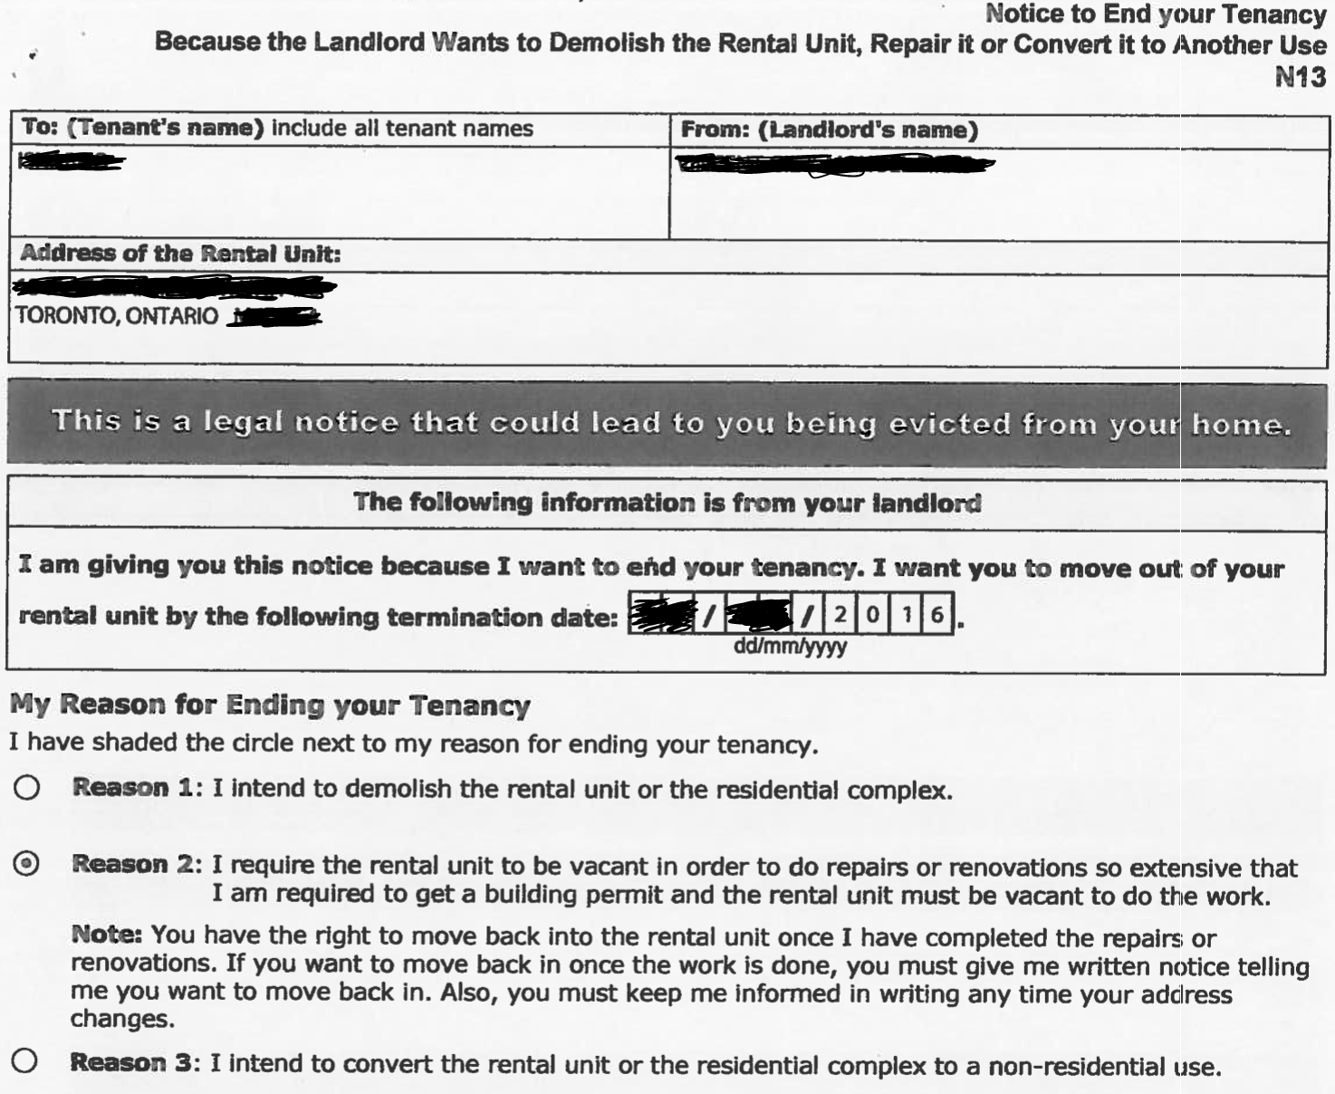
(day of fire)

Slide 16
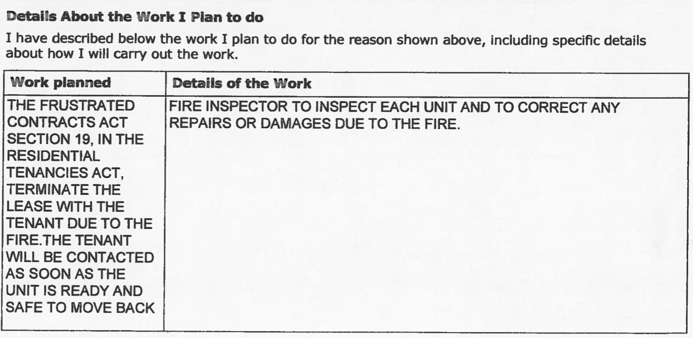
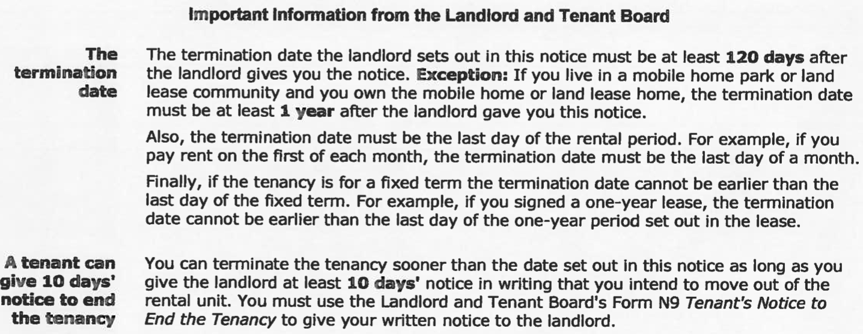

Slide 17
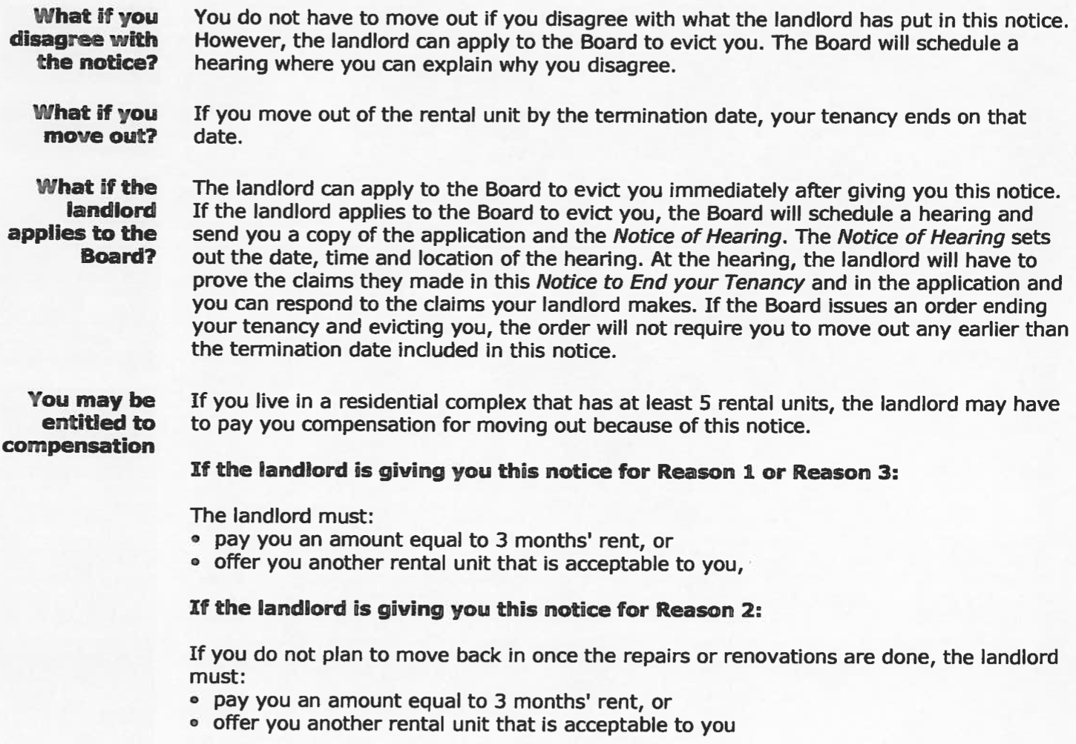

Slide 18
Timeline
DAY 1: fire, doors broken down to all units, extensive smoke damage, tenants ordered to stay elsewhere by fire department
DAY 2: landlord serves N13 notice of termination purporting to terminate tenancies SAME DAY
DAY 3: landlord sends letter to all tenants telling them to remove belongings from units ASAP, offering to return LMR deposits for those who don’t wish to return
DAY 11: landlord sends second letter saying contracts frustrated, all LMR deposits will be returned
DAY 21: one tenant writes letter attempting to exercise right of first refusal
DAY 28: landlord files LTB A1 application about whether Residential Tenancies Act, 2006 applies

Slide 19
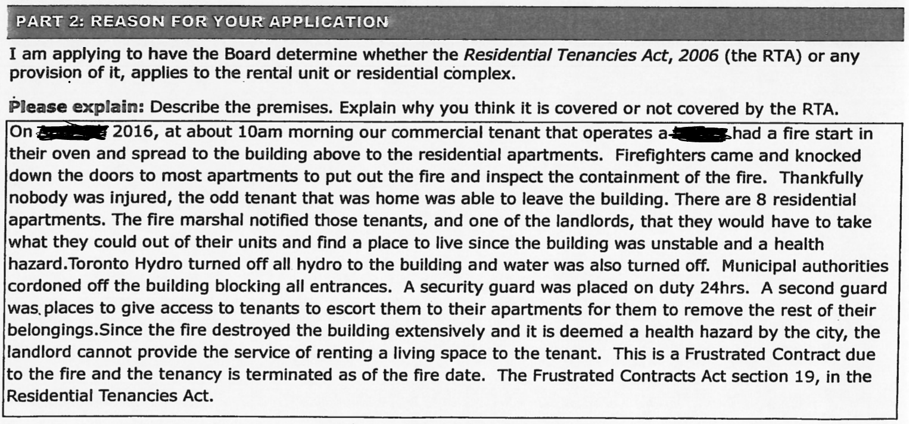

Slide 20
Issues
Law and equity at the Landlord and Tenant Board
Third-party fires as frustration of contract
The covenant for habitability

Slide 21
Law, equity, jurisdiction
50. (1) A landlord may give notice of termination of a tenancy if the landlord requires possession of the rental unit in order to,
(a) demolish it;
(b) convert it to use for a purpose other than residential premises; or
(c) do repairs or renovations to it that are so extensive that they require a building permit and vacant possession of the rental unit.
Same
(2) The date for termination specified in the notice shall be at least 120 days after the notice is given and shall be the day a period of the tenancy ends or, where the tenancy is for a fixed term, the end of the term.
Same
(3) A notice under clause (1) (c) shall inform the tenant that if he or she wishes to exercise the right of first refusal under section 53 to occupy the premises after the repairs or renovations, he or she must give the landlord notice of that fact in accordance with subsection 53 (2) before vacating the rental unit.

Slide 22
Law, equity, jurisdiction
Tenant’s right of first refusal, repair or renovation
53. (1) A tenant who receives notice of termination of a tenancy for the purpose of repairs or renovations may, in accordance with this section, have a right of first refusal to occupy the rental unit as a tenant when the repairs or renovations are completed.
Written notice
(2) A tenant who wishes to have a right of first refusal shall give the landlord notice in writing before vacating the rental unit.
Rent to be charged
(3) A tenant who exercises a right of first refusal may reoccupy [at the previous rent]
Tenant’s right to compensation, repair or renovation
54. (1) A landlord shall compensate a tenant who receives notice of termination of a tenancy under section 50 for the purpose of repairs or renovations in an amount equal to three months rent or shall offer the tenant another rental unit acceptable to the tenant if,
(a) the tenant does not give the landlord notice under subsection 53 (2) with respect to the rental unit;
(b) the residential complex in which the rental unit is located contains at least five residential units; and
(c) the repair or renovation was not ordered to be carried out under the authority of this or any other Act.
Same
(2) A landlord shall compensate a tenant who receives notice of termination of a tenancy under section 50 for the purpose of repairs or renovations in an amount equal to the rent for the lesser of three months and the period the unit is under repair or renovation if,
(a) the tenant gives the landlord notice under subsection 53 (2) with respect to the rental unit;
(b) the residential complex in which the rental unit is located contains at least five residential units; and
(c) the repair or renovation was not ordered to be carried out under the authority of this or any other Act.

Slide 23
Law, equity, jurisdiction
RTA s. 168(2): LTB has exclusive jurisdiction
RTA s. 174: power to determine law and fact
Tenancies are common law contracts wrapped in statute – [1996] 1 S.C.R. 186
BUT: LTB has no jurisdiction to apply estoppel or other equitable doctrines without statute!
Klymko v. Lem, [2001] O.J. No. 156, 1086891 Ontario Inc. v. Barber, [2007] O.J. No. 2046, Pasternak v. 3011650 Nova Scotia Ltd. (c.o.b. Michipicoten Forest Resources), 2014 ONSC 1012
This approach reversed for Small Claims Court (because, DUH): Grover v. Hodgins, 2011 ONCA 72

Slide 24
Fires and frustration
Fire renders unit uninhabitable, major repairs required, no N13 notice served…
Tenant at fault? Eviction.
Landlord at fault? Tenant application.
Neither at fault?
RTA s. 19: “The doctrine of frustration of contract and the Frustrated Contracts Act apply with respect to tenancy agreements.”
“Lord Strathcona” [1926] A.C. 108 at 114 (P.C.) and National Carriers Ltd. [1981] 1 All E.R. 161 at 175 (H.L.)

Slide 25
Fires and frustration
RTA s. 4(1): “…a provision in a tenancy agreement that is inconsistent with this Act or the regulations is void.”
Tenant: ordinary cleanliness, liable for willful or negligent damage, but not ordinary wear & tear
Landlord: maintenance and repair
Complete code, right?
uh... Stanbar Properties Ltd. v. Rooke, [2005] O.J. No. 6363

Slide 26
The covenant for habitability
RTA s. 20(1): “A landlord is responsible for providing and maintaining a residential complex, including the rental units in it, in a good state of repair and fit for habitation and for complying with health, safety, housing and maintenance standards.”
but… McQuestion v. Schneider, [1975] O.J. No. 2279 (OCA)
worse… Onyskiw v. CJM Property Management Ltd., 2016 ONCA 477

