Slide 1

Proof beyond reasonable doubt:
Carol Boothby,
Elaine Hall and
Cath Sylvester,
Legal Education and Professional Skills
Interactive seminar
What can routine programme data tell us about the impact of clinic on student performance?
ACCLE/ IJCLE Conference
July 2016
University of Toronto

Slide 2
What do we really know about the impact of clinical legal education on our students?
Claims
Students are better prepared for practice
Students learn law more effectively through experience
Students integrate legal knowledge and skills
Students gain confidence
Students values and self-concept are changed
Clinic benefits less traditionally academic students
Evidence
Feedback from alumni and employers (Alexander and Boothby)
Casework and performance in clinic, anecdotal
Casework and performance in clinic, (Boothby and Sylvester) And…
Student feedback
Mixed evidence (McKeown)
Anecdotal…. Until….

Slide 3
Raw data
4th year
1st year modules

Slide 4
Descriptive data
What do our students leave with?
What happens year on year?
class
 |  | Frequency | Percent | Valid Percent | Cumulative Percent
Valid | First Class | 40 | 23.5 | 23.5 | 23.5
 | Upper Second Class | 106 | 62.4 | 62.4 | 85.9
 | Lower Second Class | 10 | 5.9 | 5.9 | 91.8
 | Defer/Refer | 14 | 8.2 | 8.2 | 100.0
 | Total | 170 | 100.0 | 100.0
 |  | y1average | y2average | y3average | y4average
N | Valid | 169 | 170 | 170 | 170
 | Missing | 1 | 0 | 0 | 0
Mean |  | 55.01 | 56.75 | 61.75 | 64.80
Median |  | 54.33 | 56.74 | 60.73 | 65.14
Mode |  | 47.83ª | 46.80ª | 58.75ª | 68.56
Std. Deviation |  | 8.84 | 6.97 | 5.72 | 7.45
Range |  | 71.28 | 40.20 | 27.50 | 54.25

Slide 5
Contextual data
Grade boundaries and ‘fuzziness’
Percentage achieved | Y1/Y2 | Y3/4
41- | Fail/ 3 borderline | Fail
47-42 | Solid third | Fail
51-48 | 3/ 2:2 Borderline | Fail/ 2:2 Borderline
57-52 | Solid 2:2 | Solid 2:2
61-58 | 2:2/ 2:1 Borderline | 2:2/ 2:1 Borderline
67-62 | Solid 2:1 | Solid 2:1
71-68 | 2:1/ 1 Borderline | 2:1/ 1 Borderline
72+ | Solid First | Solid First

Slide 6
Does prior attainment predict final grade? (year 1)
Final degree class * y1fuzzy Crosstabulation |  | y1fuzzy |  |  |  |  |  |  |  |  | Total
 |  | solid first | first 2:1 borderline | solid 2:1 | 2:1 2:2 borderline | solid 2:2 | 2:2 third borderline | solid third | 3 fail borderline | Other/defer/refer
First Class | Count | 3 | 7 | 10 | 8 | 9 | 1 | 2 | 0 | 0 | 40
 | Expected Count | 1.2 | 1.7 | 5.9 | 5.9 | 9.0 | 7.3 | 8.3 | .5 | .2 | 40.0
Upper Second Class | Count | 1 | 0 | 12 | 17 | 26 | 24 | 25 | 0 | 0 | 105
 | Expected Count | 3.1 | 4.3 | 15.5 | 15.5 | 23.6 | 19.3 | 21.7 | 1.2 | .6 | 105.0
Lower Second Class | Count | 0 | 0 | 2 | 0 | 1 | 4 | 2 | 1 | 0 | 10
 | Expected Count | .3 | .4 | 1.5 | 1.5 | 2.2 | 1.8 | 2.1 | .1 | .1 | 10.0
Defer/ Refer | Count | 1 | 0 | 1 | 0 | 2 | 2 | 6 | 1 | 1 | 14
 | Expected Count | .4 | .6 | 2.1 | 2.1 | 3.1 | 2.6 | 2.9 | .2 | .1 | 14.0
Total | Count | 5 | 7 | 25 | 25 | 38 | 31 | 35 | 2 | 1 | 169

Slide 7
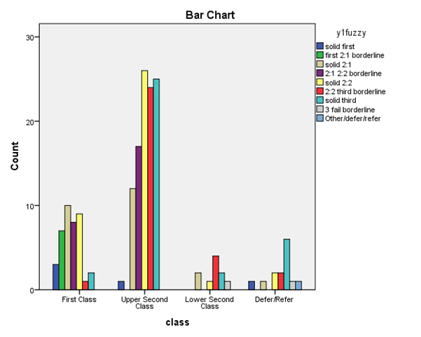
By eye: you can’t spot the firsts

Slide 8
What’s happening in year 3?
Final degree class * y3fuzzy Crosstabulation |  |  | y3fuzzy |  |  |  |  |  | Total
 |  |  | solid first | first 2:1 borderline | solid 2:1 | 2:1 2:2 borderline | solid 2:2 | 2:2 fail borderline
 | First Class | Count | 9 | 11 | 16 | 4 | 0 | 0 | 40
 |  | Expected Count | 2.1 | 3.5 | 11.3 | 11.8 | 10.8 | .5 | 40.0
 | Upper Second Class | Count | 0 | 3 | 31 | 40 | 30 | 2 | 106
 |  | Expected Count | 5.6 | 9.4 | 29.9 | 31.2 | 28.7 | 1.2 | 106.0
 | Lower Second Class | Count | 0 | 0 | 0 | 2 | 8 | 0 | 10
 |  | Expected Count | .5 | .9 | 2.8 | 2.9 | 2.7 | .1 | 10.0
 | Defer/ Refer | Count | 0 | 1 | 1 | 4 | 8 | 0 | 14
 |  | Expected Count | .7 | 1.2 | 4.0 | 4.1 | 3.8 | .2 | 14.0
Total |  | Count | 9 | 15 | 48 | 50 | 46 | 2 | 170

Slide 9
Raw data
3rd year

Slide 10
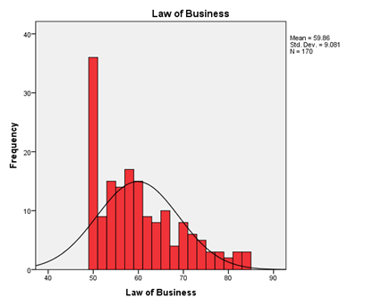
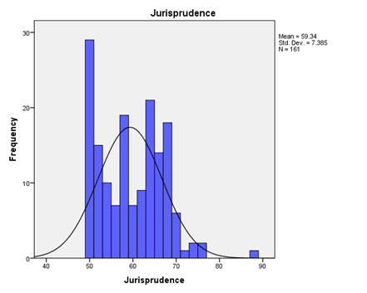
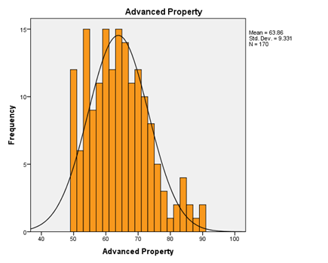
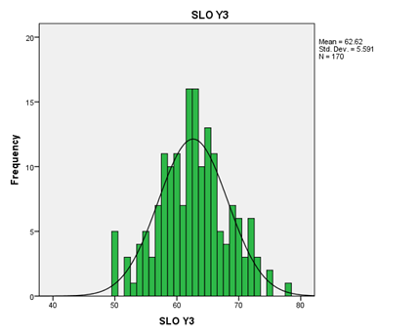
Core modules (year 3)

Slide 11
SLO year 3 driving the trend?
Final degree class * y3SLOfuzzy Crosstabulation |  |  | y3SLOfuzzy |  |  |  |  |  | Total
 |  |  | solid first | first 2:1 borderline | solid 2:1 | 2:1 2:2 borderline | solid 2:2 | 2:2 fail borderline
 | First Class | Count | 4 | 8 | 21 | 4 | 3 | 0 | 40
 |  | Expected Count | 2.8 | 4.7 | 16.7 | 9.2 | 5.4 | 1.2 | 40.0
 | Upper Second Class | Count | 5 | 11 | 45 | 26 | 16 | 3 | 106
 |  | Expected Count | 7.5 | 12.5 | 44.3 | 24.3 | 14.3 | 3.1 | 106.0
 | Lower Second Class | Count | 1 | 1 | 2 | 3 | 2 | 1 | 10
 |  | Expected Count | .7 | 1.2 | 4.2 | 2.3 | 1.4 | .3 | 10.0
 | Defer/ Refer | Count | 2 | 0 | 3 | 6 | 2 | 1 | 14
 |  | Expected Count | 1.0 | 1.6 | 5.8 | 3.2 | 1.9 | .4 | 14.0
Total |  | Count | 12 | 20 | 71 | 39 | 23 | 5 | 170
Final degree class * y3fuzzy Crosstabulation |  |  | y3fuzzy |  |  |  |  |  | Total
 |  |  | solid first | first 2:1 borderline | solid 2:1 | 2:1 2:2 borderline | solid 2:2 | 2:2 fail borderline
 | First Class | Count | 9 | 11 | 16 | 4 | 0 | 0 | 40
 |  | Expected Count | 2.1 | 3.5 | 11.3 | 11.8 | 10.8 | .5 | 40.0
 | Upper Second Class | Count | 0 | 3 | 31 | 40 | 30 | 2 | 106
 |  | Expected Count | 5.6 | 9.4 | 29.9 | 31.2 | 28.7 | 1.2 | 106.0
 | Lower Second Class | Count | 0 | 0 | 0 | 2 | 8 | 0 | 10
 |  | Expected Count | .5 | .9 | 2.8 | 2.9 | 2.7 | .1 | 10.0
 | Defer/ Refer | Count | 0 | 1 | 1 | 4 | 8 | 0 | 14
 |  | Expected Count | .7 | 1.2 | 4.0 | 4.1 | 3.8 | .2 | 14.0
Total |  | Count | 9 | 15 | 48 | 50 | 46 | 2 | 170

Slide 12
Raw data

Slide 13
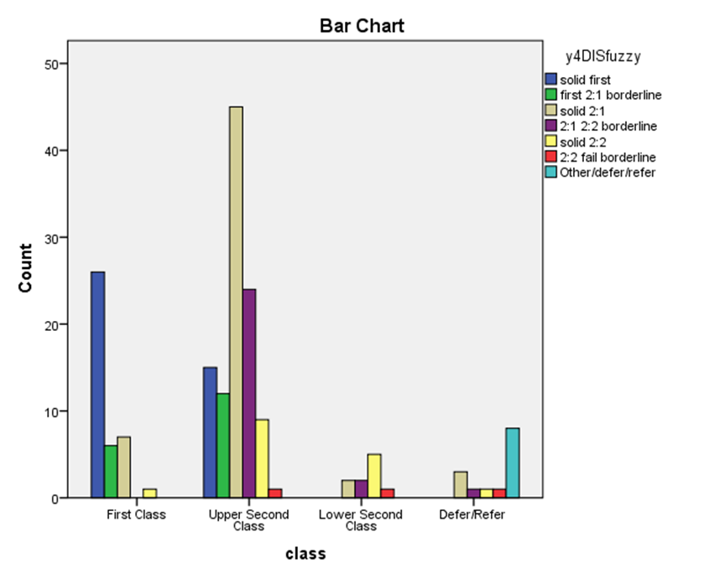
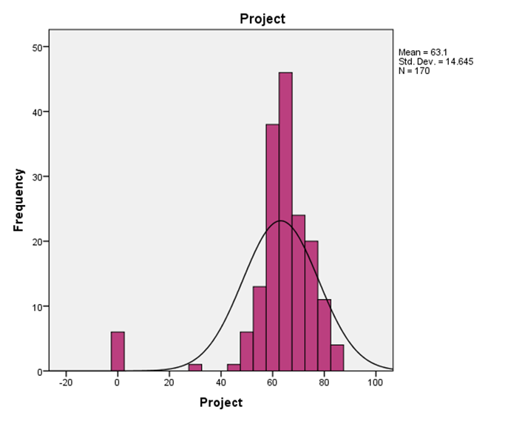
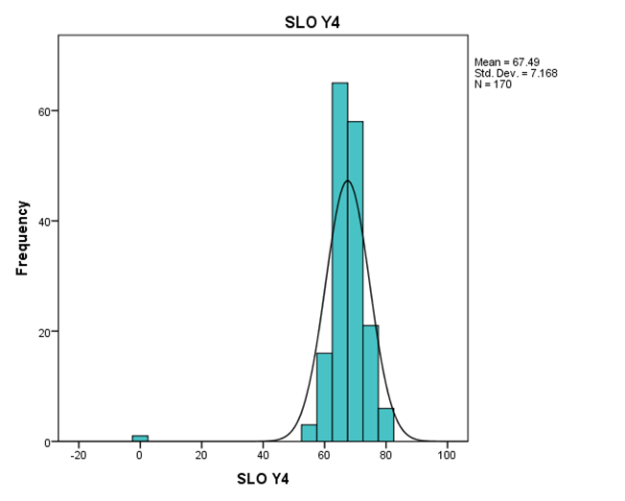
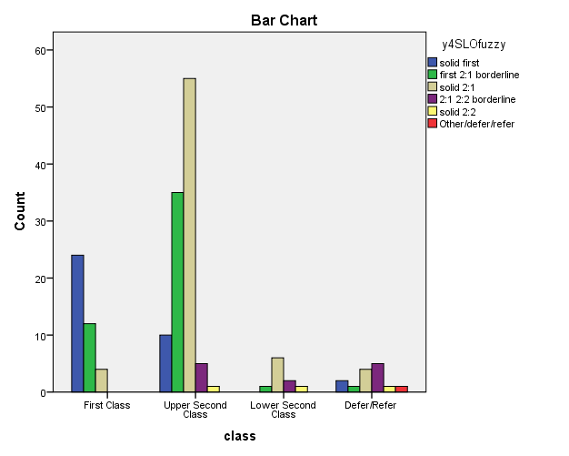
Year 3 predicts Year 4 – just a clinic effect?

