Slide 1

Public Interest Law Initiative
Catalysing Clinic

Slide 2

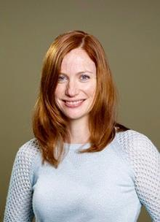
Introductions
Notes:
Kate

Slide 3
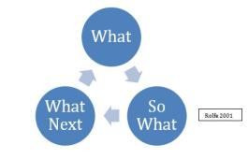
Today
The Rewards and the Risks – our
experience in Catalysing Clinic
Part I – The rewards
PILI’s evolution – what, why and how?
Create – catalyse – consolidate
The Umbrella structure
Part II – The risks
Governance
  the ABC of stakeholder management
  Clinical literacy
Part III – Looking (back) to the Future
Notes:
Kate

Slide 4
PILI’s Past
PILI’s birthday
PILI’s aims
PILI – the pros and cons of a late arrival
Notes:
Kate

Slide 5
PILI’s Evolution
The PILI appointment
Teaching Specialist
Senior Lecturer
Ongoing
Direct reporting
The Briefs
  Create
    Pre 2012 clinical canvas
  2014 – 2015 Catalyse
    The handover
  2016 + Consolidation and credibility
Notes:
Claire then Kate

Slide 6
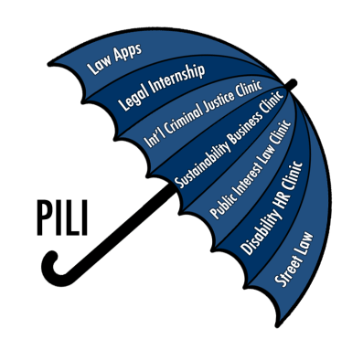
PILI Clinics
Intro to PILI’s suite of clinics
  Legal Internship
  Street Law
  Public Interest Law Clinic
  Sustainability Business
    Clinic
  Disability Human Rights
    Clinic
  Law Apps
  International Criminal
    Justice Clinic
Notes:
Kate

Slide 7
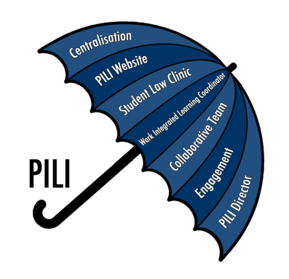
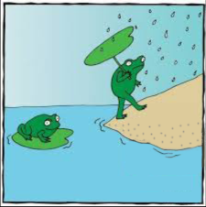
PILI’s Umbrella Structure
The Rewards
Why?
Clinical Director
Shared resources
Clinical Fellowship
Centralised Work Integrated Learning
Notes:
Claire

Slide 8

PILI’s Umbrella Structure
The Rewards: Conceptual Features
What is the ‘Umbrella Structure’?
Centralisation and Engagement
  Academic memory
  Corporate memory
  Streamlining resouces
  Clinical cleaning
Notes:
Kate

Slide 9
PILI’s Umbrella Structure
The Rewards: Practical Features
Centralisation and Engagement
  Student Law Clinic – research
  and development; construction;
  Student and faculty engagement
  Clinical identity
  Clinical literacy
  PILI website
Notes:
Kate

Slide 10
Utopia v Reality
What does it look like?
Notes:
Claire then both to do feedback

Slide 11
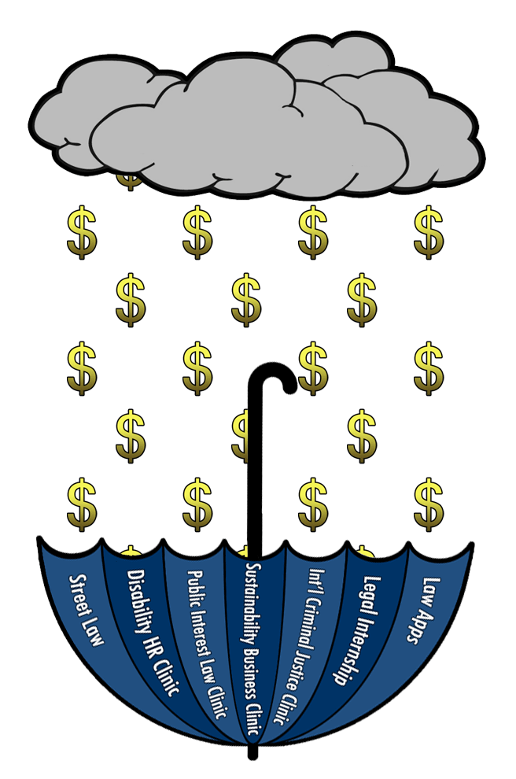
The Risks
Resources
  Show me the money!
Notes:
Claire

Slide 12
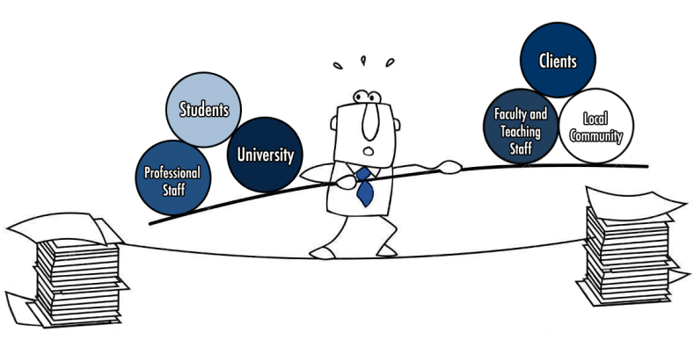
The Risks
Stakeholder Balancing
Who are the stakeholders?
What do we do with them?
The ABC of stakeholder balancing
  Articulate Interests
  Balance Interests
  Check up!
Notes:
Claire

Slide 13
Stakeholder Management
How To Be a Clinical Champion
What makes a good clinical partner?
Clinical partnerships and selection
Good clinical parenting – when to say no
Appreciation of the impacts of clinical commodification
Approachable
Functionality – continuity of clinical teaching
Notes:
Kate

Slide 14
Stakeholder Management
How To Be a Clinical Champion
How to be a good university partner
  Understand, particularly resources
  Encourage – academic anchoring for sustainability
  Explain – university resources
Notes:
Kate

Slide 15
The Risks
Clinicians at the Fringe?
Clinical literacy: a secondary challenge
  Sociologically, clinical teachers often seem to float at the margin of their professional culture. They are considered less intellectual and less academic; they actually venture beyond classroom to courthouse; and their teaching may make explicit those considerations of justice that their institutions instinctively prefer to keep implicit and silent.
  Auerbach, Jerold ‘What has the teaching of law got to do with justice?’ (1978) 54 NYUL Rev 471.
Notes:
Claire

Slide 16

Clinicians at the fringe?
The Risks: What Happens When It Rains?
How to improve clinical literacy in a traditional, research focused faculty?
Our best practice suggestions:
  Implement an umbrella structure
  Offer a physical and pedagogic presence in the law school
  Protective effect
  United voice for governance
Notes:
Kate

Slide 17
Change and the Legal Academy
Clinical literacy and the legal academy
  Change society and legal education will change. Short of that, however, it may be possible to tinker so as to encourage the more equitable distribution of legal services. So the clinical teachers, at least, have demonstrated.
  Auerbach, Jerold ‘What has the teaching of law got to do with justice?’ (1978) 54 NYUL Rev 474.
Are we ‘tinkering’?
Notes:
Claire

Slide 18
PILI
Tinkering by Design
Why are quotes like Auerbach’s resonating for clinicians 50 years later?
Why is the legal academy so resistant to change?
We don’t know! However, PILI’s exponential growth gives us hope
PILI has commenced its inaugural research into the effects of clinical legal education
As novice researchers, we ‘tinker by design’ with the hope that we may offer a simple but meaningful contribution to legal education
All insights and contributions from the clinical network are welcome
Notes:
Kate to do this.
Talk at the end about the climate being right – (why is this so?)
Positive -

