Slide 1

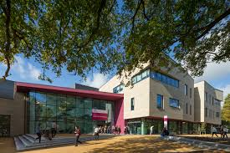

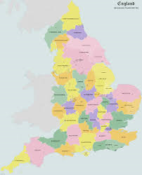
The Risks and Rewards of Clinical Legal Education
'Clinic, the University and Society'
Complimentary Services - CLE is not designed to fill the legal aid gap, but why not use it to everyone's advantage?
Vinny Kennedy
Principal Lecturer, Solicitor, PG Cert. LTHE FHEA
Department of Law & Criminology
E-mail: v.kennedy@shu.ac.uk
Tel: 0114 225 54 51

Slide 2
Context
Legal Aid, Sentencing and Punishment of Offenders Act 2012
'The Ministry of Justice estimates that its legal aid reforms will cut the income of the NFP (Not for Profit) sector by 92%' (Sommerlad and Sanderson, 2013)
'on average, Law Centres have lost 40% of their funding since 2011' (Law Centres Network, 2015)

Slide 3
Seeking opportunities
'unavailability of legal assistance for individual clients unable to afford to pay for it is a social justice issue to which law schools can respond' (Wizner, 2001)
'for the majority of clinics, the educational value of the case is seen as being the most important reason to take on a client's case' (Ulster University, 2015)
Alternatives to legal aid:
  'informing, educating and assisting disputing parties to represent themselves in court
  alternative methods of providing free or low-cost legal services; and
  modification of the court process so it is not so reliant on lawyers' (Hunter, 2014)

Slide 4
Court Helpdesk
Dialogue commenced in 2013, and the project was launched in October 2014
Small Claims Court
Operation
  opening times
  personnel
  scope of assistance
  types of cases
  statistics

Slide 5
Benefits
Enhancing student experience
Contributing to student employability strategy
Student feedback:
'The Court Helpdesk has taught me so much about the procedures in Court. It has also been an enriching experience because of the opportunity to assist so many litigants and have so much contact with them and with the legal system'.
HHJ Robinson:
'the Helpdesk has become an indispensable component in the smooth running of the Court process on Small Claims day'.
Awards:
  The Lawyer, Best Ethical Initiative 2015
  Law Excellent Award

Slide 6
Challenges
Inability to provide legal advice
Competing stakeholder interests
Pro bono dressed as CLE
Assessing the impact
  court staff
  litigants in person

Slide 7
References
R. Hunter, 'Access to Justice after LASPO' (2014) 44 FLJ 581
Geraldine Gupta 2014
R. Grimes, 'Learning law by doing law in the UK' (2000) 1 JCLE 54
Law Centres Network, Law centres Annual Review 2014/2015: Picking Up the Pieces (2015) < http://www.lawcentres.org.uk/policy-and-media/papers-and-publications/annual-reviews> date accessed 21 April 2016
Letter from HHJ Robinson to Sheffield Hallam University (11 February 2015)
MOJ 2011a in H. Sommerlad and P. Sanderson, 'Social Justice on the Margins: the future of the not for profit sector as providers of legal advice in England and Wales' (2013) JSWFL 305
Ulster University, 'Access to Justice through University Law Clinics' October 2015
K. Williams, 'Litigants in person: a literature review' (2011) MOJ<www.gov.uk/government/uploads/system/uploads/attachment_data/file/217374/litigants-in-person=literature-review.pdf>date accessed 21 April 2016
S. Wizner, 'Beyond Skills Training' (2001) 7 CLR 327

Slide 8

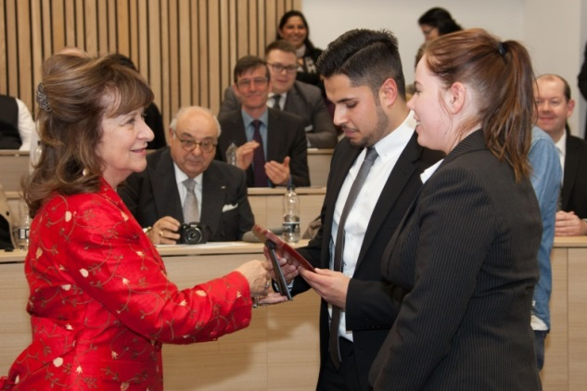

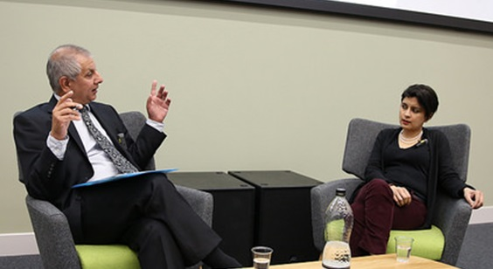

The central values of the centre:
widening access to justice
promotion of human rights
ethics in legal practice
overcoming social injustice
enabling desistance and recovery
promoting criminal justice accountability
The centre has the following goals:
to impact on policy and provide advocacy
to innovate in teaching and education
to produce research and scholarship work
to support local, national and international projects and events
@SHULawCrim
www.shu.ac.uk/dlc/helena-kennedy-centre

