Slide 1
I didn’t think this sort of thing happened any more: The student experience in discrimination law clinics
Dianne Anagnos

Slide 2
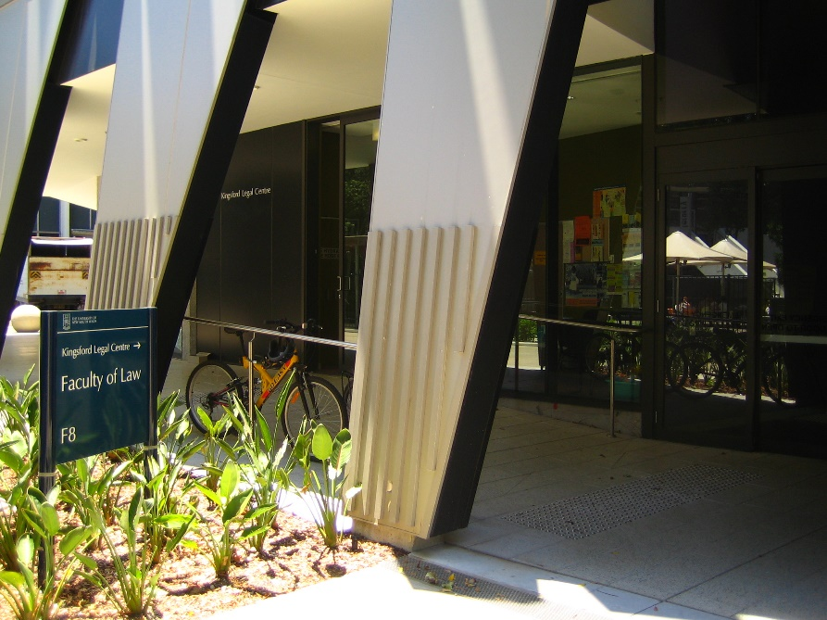
Kingsford Legal Centre
Community Legal Centre
Established in 1981
Part of UNSW Australia’s Law Faculty
10 Staff – 7 solicitors
Advice and casework
Community Legal Education
Community Development
Law Reform and Policy
Clinical Legal Education
Specialist clinics in employment law, discrimination law, community legal education in family law and domestic violence

Slide 3
Some of our aims and objectives
To educate tomorrow’s lawyers by:
  Giving students an opportunity in a clinical supervised setting to work for disadvantaged clients
  Developing student understanding of how the legal system works and its impact upon disadvantaged clients
  Providing students with an opportunity to reflect upon social justice issues, the legal system and the role of lawyers within it including the values and objectives underpinning the work of community legal centres
  Assisting students to understand the integral role that systemic advocacy and community legal education play in legal service provision.
To reduce discrimination through the provision of specialised legal advice and representation on discrimination matters to residents of NSW and those who are discriminated against in NSW.

Slide 4
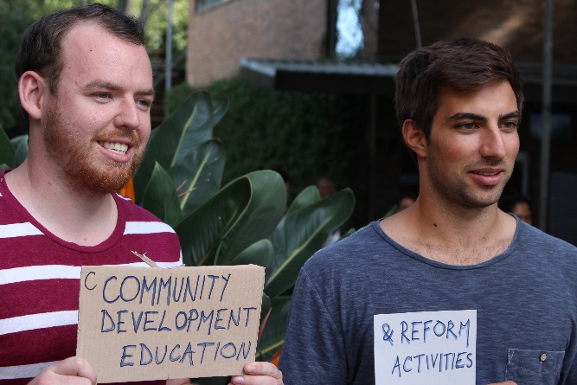
Our courses
1st Year: Foundations Enrichment II: This is a course for 1st year Indigenous students focusing on communication skills, legal interviewing and the legal aid system.
2nd/3rd Year: Interviewing Component in Lawyers, Ethics and Justice: Students interview KLC clients and write a reflective assignment on it. These students are taught interviewing skills by KLC solicitors and spend five hours at the Centre in an evening legal advice session interviewing clients and working with volunteer solicitors.
Legal aid and Global Justice Lawyering: Issues in Practice
KLC Community Law Clinics: (1 or 2 Days) & KLC Employment Law Clinic (2 Days):KLC Family Law/Family Violence Community Education Clinic (1 Day)

Slide 5
Discrimination law in New South Wales
No National Human Rights Act, Bill of Rights or equivalent single document in Australia
State Exceptions in Victoria and the Australia Capital Territory
Discrimination laws are one of the main ways international human rights are protected in NSW
Discrimination laws exist at both State and Federal levels

Slide 6
Students’ limited exposure to anti-discrimination laws
Discrimination law is not a compulsory subject in our law degrees
I have really enjoyed gaining more exposure to common issues that bring about anti-discrimination cases and the avenues available to victims. The Wednesday afternoon class was also informative and provided a good context for what we encountered in the clinic. I have learned about the types of discrimination that are protected against in Australia (eg. Disability), situations in which they occur (eg. accommodation) and bodies to bring actions to (Anti-Discrimination Board in NSW). Before this course, I had also never considered that discrimination can be indirect...
Quote from student reflection, Semester 1 2016

Slide 7
Discrimination law in New South Wales
Race
Disability
Sexual orientation
Gender Identity
Intersex status
Sex
Age
Pregnancy
Carer’s responsibilities
Marital status
Sexual harassment
Victimisation

Slide 8
Discrimination Law in New South Wales
Mandatory conciliation process
Court or Tribunal

Slide 9
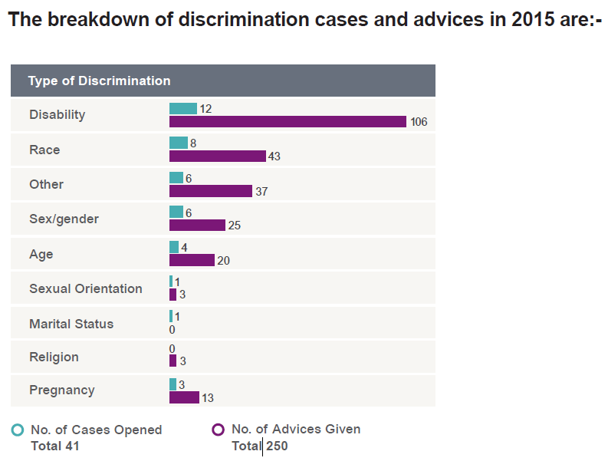
Discrimination advice and casework

Slide 10
The students’ role in the discrimination clinic
Intake
Interviewing clients
Research
Assisting with casework:
Attending conciliation conferences
Assisting with drafting complaints and settlement proposals
Working on strategy for the conciliation process
Learning about managing client expectations

Slide 11
Case studies
Disability Discrimination in Housing
KLC was contacted by a community worker about a client who had received a notice of eviction from a social housing provider. The client had been absent from her house for longer than the “allowable period” under their housing eligibility policies. The client had been receiving medical treatment the entire time she was “absent”. KLC lodged a discrimination complaint just before the social housing provider commenced Tribunal proceedings to evict her. We lodged a discrimination complaint and went to a conciliation conference. We argued that the policies were discriminatory in that people with a disability were more likely to be absent from their homes for significant periods of time in order to receive medical treatment The complaint was settled and the client was not evicted.

Slide 12
Case studies
Race discrimination
KLC settled a long-running discrimination complaint against a function centre that cancelled our clients’ event at the last minute on the basis of their race. They stated that they would not go ahead with the event as people from our clients’ ethnic backgrounds “always cause trouble”. The cancellation affected our clients as well as their guests. KLC represented the clients in their race discrimination complaint and negotiated a settlement outcome consisting of both compensation for economic and non-economic loss and an apology.

Slide 13
Case studies
Sexual Harassment and Victimisation
KLC represented a client who was employed on a migrant visa. The client was sexually harassed by a manager, who threatened to withdraw sponsorship of her visa if she didn’t accept his advances. The client complained to her supervisor and was terminated shortly after We lodged a complaint to the Anti-Discrimination Board alleging sexual harassment and victimisation. At conciliation we successfully settled the matter for monetary compensation.

Slide 14
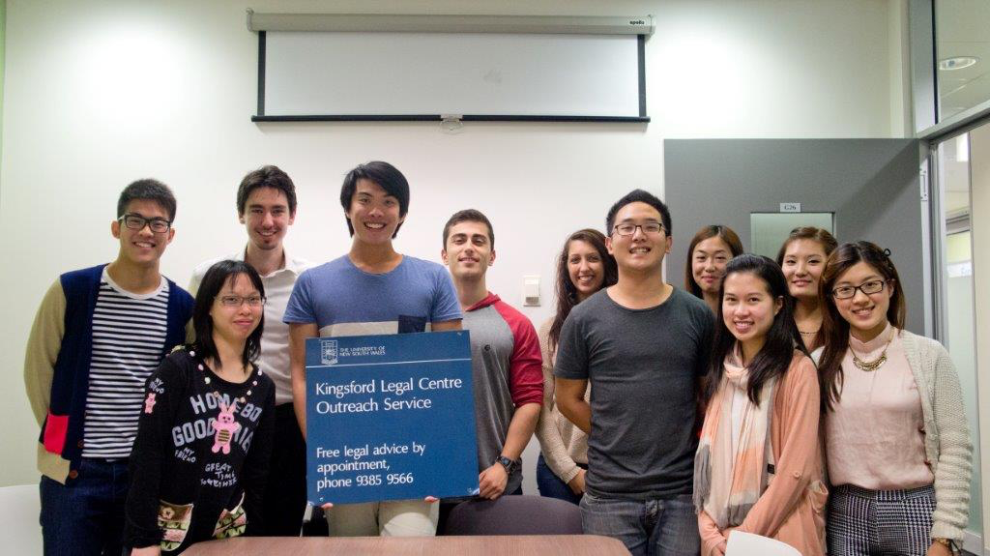
Student responses
Sources of feedback:
  Reflective journal entries Semester 1 2016- quotes with permission
  Student surveys at the end of semester
  Informal debriefing after appointments and at assessment interviews

Slide 15
1. Observations on the conciliation process
We had great evidence that the reason she was dismissed was because of her pregnancy. Although she could have pushed for more compensation, with a baby to look after she was happy to accept this offer…It wasn’t as much compensation as she could have received but she was satisfied that the issue was resolved and the other side were aware of the wrongs they had done by our client.
Vs
In one matter, where the [claim] was complicated by sexual harassment complaints, we were unsuccessful in achieving the client’s aims at the conciliation, as the employer denied the validity of the complaints and knew that the client did not want to proceed to hearing where the sexual harassment would be made public. ….. I felt quite frustrated that employers can treat vulnerable members of our society in such a poor manner, with little redress or remedy available to the clients through the legal system
Student reflections, Semester 1 2016

Slide 16
2. Limits of the complaints process
Limited scope of what complaints can deal with
I am acutely aware of the limitations of the legal system in addressing the issues the client has in regard to accessing education for her son. Listening to the client explain her situation during the calls we have made to her has highlighted the small part the discrimination complaint and its resolution will have to play in solving the problems the client and her son are having.
… a more holistic approach to this client’s situation, and that faced by many parents of children with disabilities, would be ideal.
Throughout law school, we learn about the inadequacies of the legal system, its remedies and access to justice issues. However, seeing individuals actually interact with the legal system and encounter these problems showed me that it’s not just a theoretical issue, but people do find the legal system wanting.
Student reflections, Semester 1 2016

Slide 17
Limits of complaints process (cont’d)
Limited damages/burden of proof
The solicitor explained that by pursuing the matter through the Commonwealth or State discrimination law systems, on average, only about 6-8 weeks of pay was offered at negotiations. Additionally, if the case was to move to a cost jurisdiction in the courts, complainants, including Ms B, face a strenuous task of establishing that the discrimination has actually occurred.
With community centres, including the KLC, taking an active role to cater to discrimination victims, I feel that such centres should take a proactive role in advocating for policy changes that make it easier for discrimination cases to be presented and proven, and for fairer remedies to be available to victims.
Student reflections, Semester 1 2016

Slide 18
3. Assumptions about what discrimination looks like
I was reminded that discrimination frequently occurs in situations beyond expected One client was a male victim of workplace sexual harassment, and the other used a wheelchair and had not been provided with ramp access [at a] bus stop.
Student reflections, Semester 1 2016
People should not be judged on appearances. People who are well presented may also be facing problems eg domestic violence, employment issues.
Student survey response, Semester 1 2016

Slide 19
4. Extent of discrimination
Discrimination intake project
Recognising that in the few weeks I have been at KLC I have already made many calls to clients responding to their discrimination complaints, it is indicative of the fact that discrimination complaints are more widespread than I had initially envisaged.
Student reflections, Semester 1 2016
The discrimination clinic was a great opportunity to realise that discrimination does exist at all levels of our society.
(I became aware of) racial disadvantage (especially with the large Indigenous community); Power imbalance between employer and employee.
Quotes from student survey, end of Semester 1 2016

Slide 20
Supervision of students
It was devastating when the conciliator came back from her individual session with [the respondent] and said that they were refusing to put anything in writing that would bind the school… our client left feeling that the process was a waste of time. I felt completely shattered on behalf of the client….
Student reflections, Semester 1 2016

Slide 21
Supervision of students
Provide context through class material and frame in a human rights context
Importance of pre-briefing
Important of debriefing
Allowing group discussion among students
Encourage reflection
Modeling behaviour with clients- empathy, non-judgmental, even if the claim is legally baseless
Higher levels of supervision around clients with complex needs, especially around mental health
Modeling behaviour among supervisors and including the students- debriefing, working collaboratively
Be honest (but constructive) about your own reactions
Where possible, update students on progress of client’s matters
Include students in law reform and project work
Notes:
REFER TO CONCILIATION PROJECT- to feel part of a long-term solution
POINT OUT- pre-briefing and de-briefing is time consuming. Means more time is needed for appointments. Discrim matters and clients are complex, and we can’t just spend less time with the client.
Example- Sasha at conference- anger. Importance of sharing experiences with the student, relating to their feelings, showing that you have an emotional response as well. Model how to process it!

Slide 22
