Slide 1
Teaching and Learning Ethics Through A Clinical Exchange
Sarah Bujold
JoNel Newman
Melissa Swain
Fergus Lawrie
Lyndsay Monaghan
(Donald Nicolson)

Slide 2


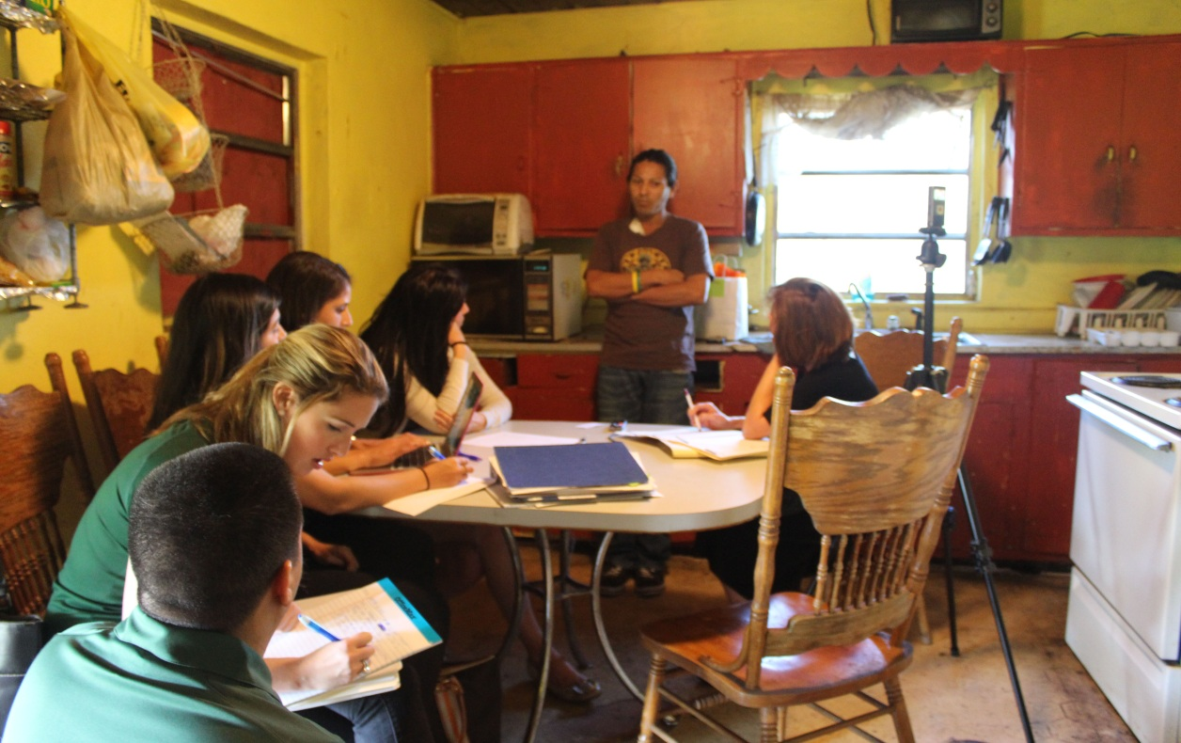
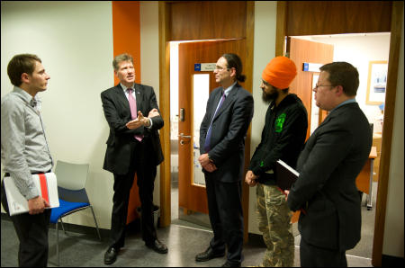


Slide 3
Advantages of Teaching Ethics Experientially
Learning experiences are realistic, involve future social roles, more profound than abstract learning
  Adult learning theory
The ‘disorienting moments’/ ‘moral crises’ which occur when prior assumptions and settled values jar with experiences stimulate an ‘engaged moral faculty’
  More memorable
Repetition is key in developing ethical habits

Slide 4
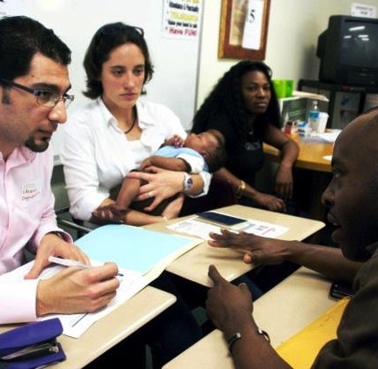
Miami Law: Health Rights Clinic
Schools of Medicine and Law MLP Clinic since 2005
HIV/AIDS Clinics
Jefferson Reaves Community Health Center
Pediatric Mobile Clinic
Homeless Veterans Service Center

Slide 5
Client Demographics
Assisting the Most Vulnerable
Race
Language

Slide 7
Miami’s “Teaching Hospital” Model
High Volume
High Stress
Repetitive Practice
⬇
Creates Ethical Professional Habits
Emphasizes Inadequacies in Access to Justice

Slide 8
Ethics Teaching in Health Rights Clinic
Begin with 16 Learning Goals
14 2L and 3L students enrolled for an academic year
10 to 12 cases, usually 6 to 8 cases at a time
High level of responsibility – students primary case handlers
Series of disorienting moments
Weekly individual meetings with supervising faculty
Weekly class includes
  Guidance on self reflection
  Ethics instruction
  Substantive law
  Skills training

Slide 9
Written Self-Reflective Materials
  Respond to series of prompts matched to Learning Goals (guided)
  Mid-point of each semester
  Suggested 3 page limit
  Half hour individual meeting with faculty to discuss
  Self-reflection on significant clinical event
    Also responds to prompts
    Students do in class

Slide 10
Ethics Teaching at Strathclyde
Only for (275) clinic students at UG level at Initial Advisor Training, compulsory for all on Diploma
Optional Ethics and Justice (Clinical Legal Practice/CLP)
  Legal ethics and issues of justice illuminated and illustrated through
    Seminars on
      Introduction to ethical theory
      professionalism and sociological context;
      client autonomy;
      conflicts and confidentiality;
      immoral means and ends;
      ethical education and regulation).
      the profession’s response to access to justice
    Reflection on cases in surgeries, diary dialogue and essays
Induction Training
Reflective diaries kept, reviewed and commented on regarding ethics issues

Slide 11
Both Clinics’ Aims
Social justice orientation
Access to justice for underserved communities
Inculcate ethical professional identity
  Skills and values – beyond minimum (code-based)
  Expose students to theories about ethics and altruism
  Repeated opportunities to make ethical judgments and responses in role
  Opportunites for reflection

Slide 12


Research Project
Two Clinics, Similar Missions,
Two Sets of Students’ Narrative Data …

Slide 13

Clinical Exchange

Slide 14
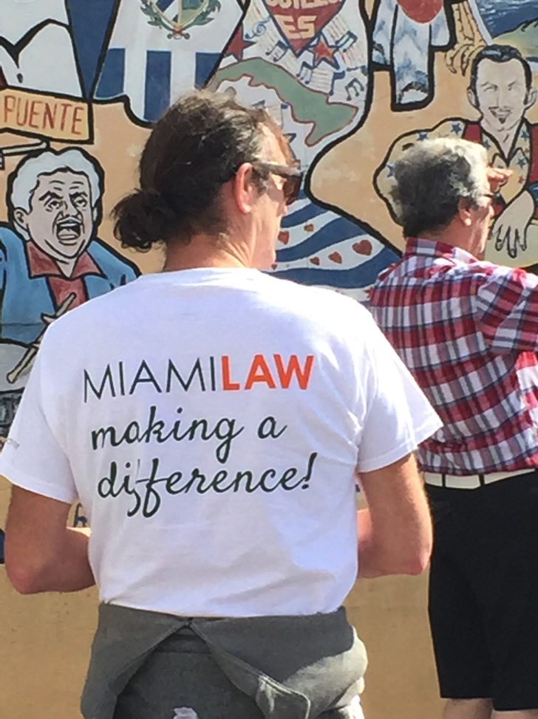

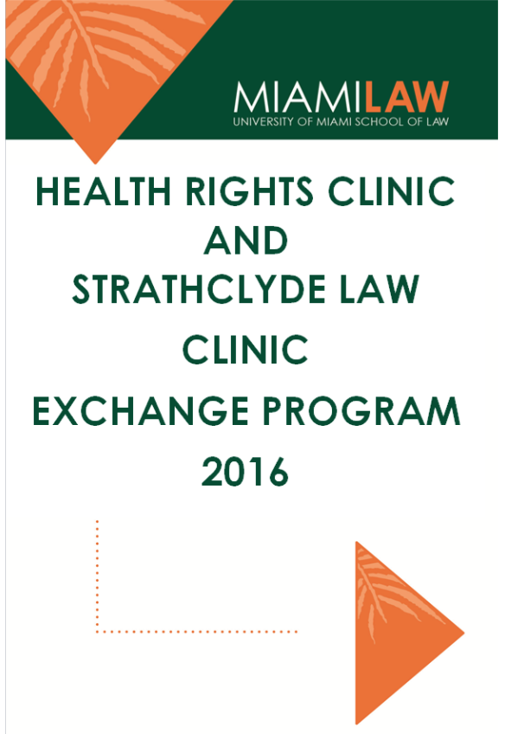
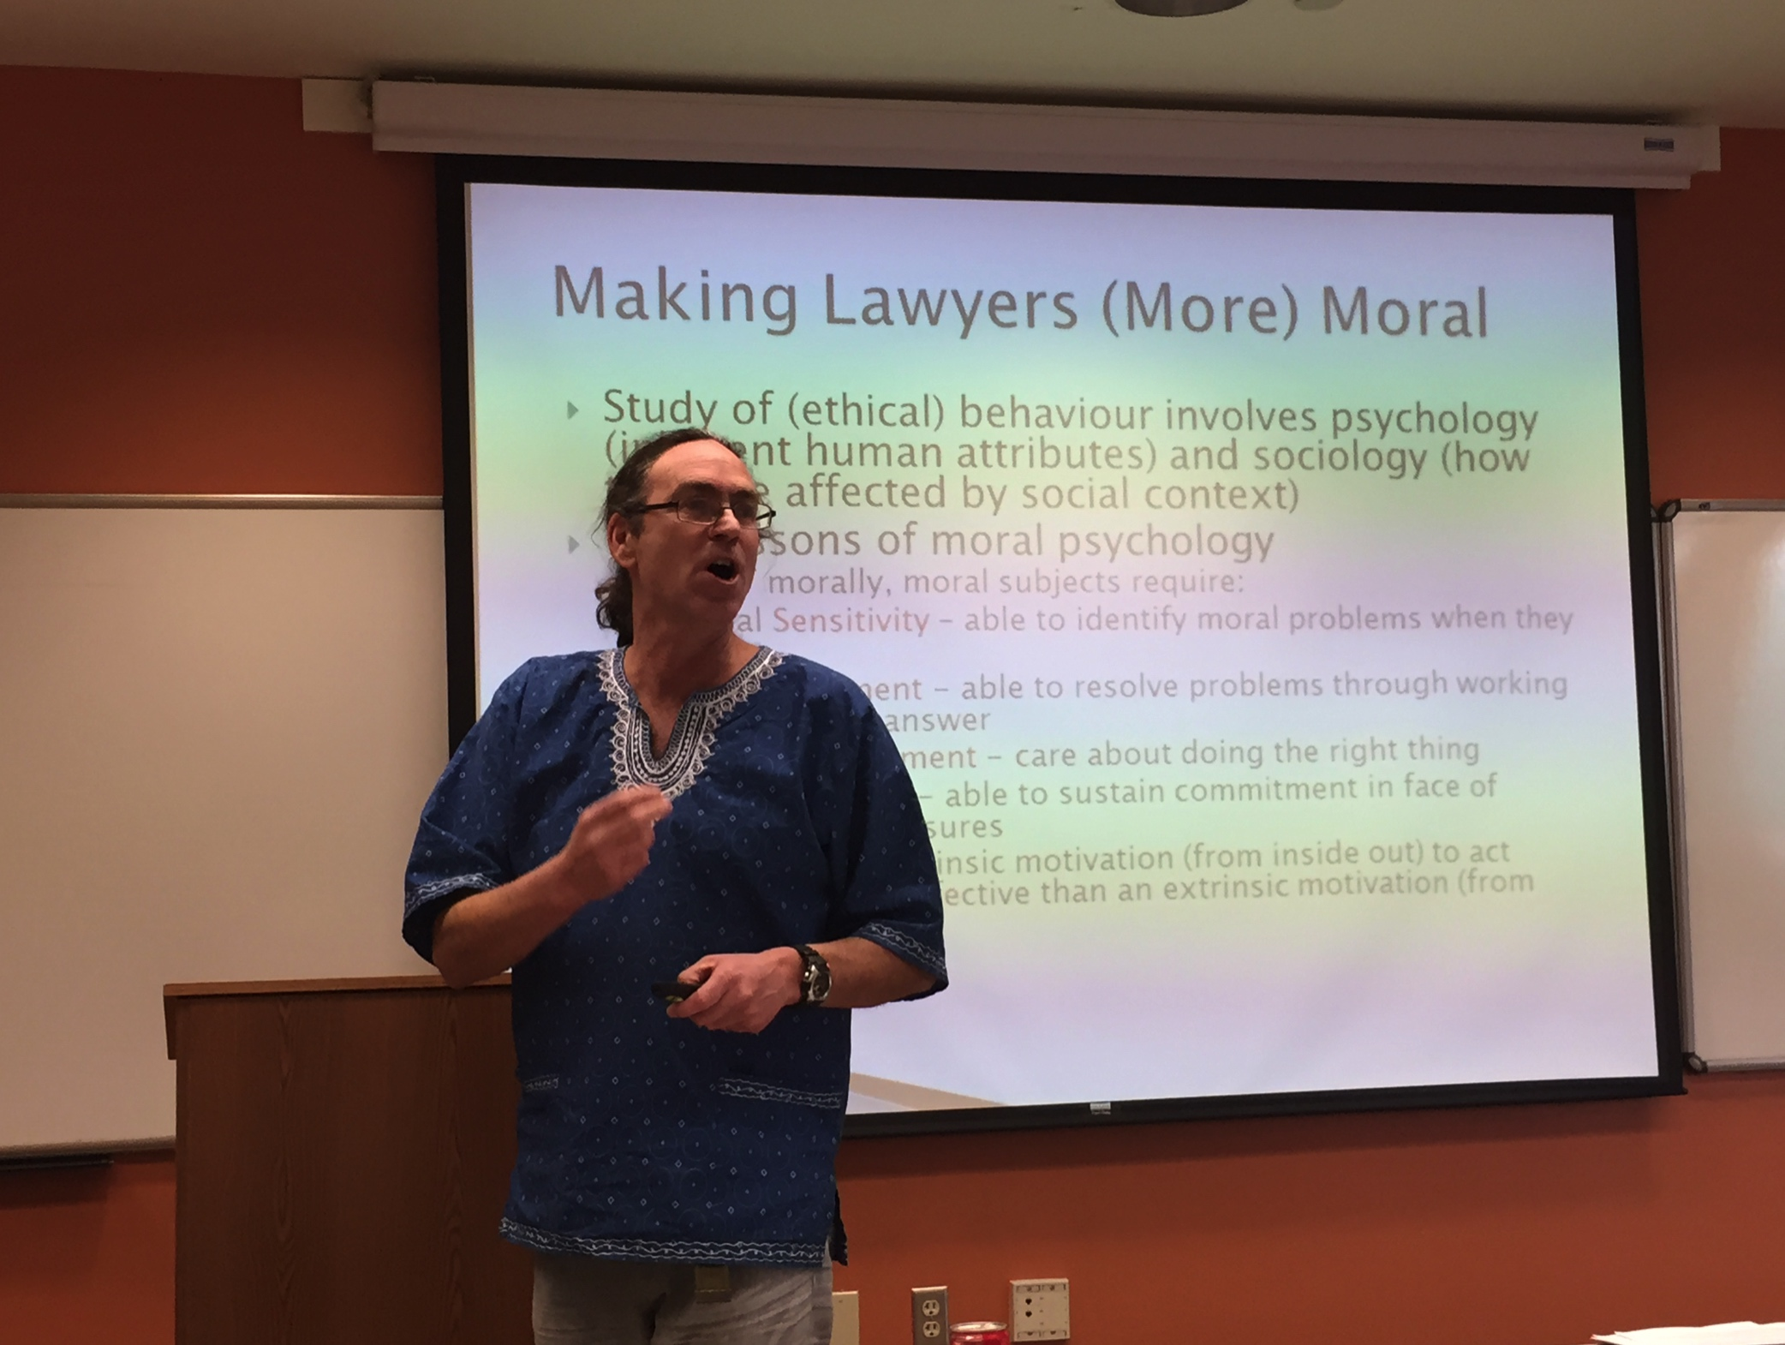

Clinical Work, Study, Culture and Presentations

Slide 15
Forum Theatre
Augusto Boal, Theater of the Oppressed
A forum for teaching people how to change their world
Audience members can stop the performance
Come on stage and perform an intervention

Slide 16
Forum Theatre Interviewing Exercise
Originally developed in first clinical exchange
Now used in Miami and Strathclyde student orientations
Has been used as a training in other contexts

