Slide 1





The Lawyer as Human Being: Legal Coaching by Law Students
Monday July 11 2016 | 11:00am – 12:30pm
Notes:
Please get me your organization logos and I’ll place them on the slides! For now, I’m keeping the formatting quite clean:

Slide 2
Agenda
Overview: What is Legal Coaching?
Pro Bono Students Canada: Windsor Coaching Pilot
Legal Information Society of Nova Scotia: Navigator Program
National SRL Support Network: Perspective of an SRL
Role Play Exercise & Discussion
Moving Forward: Developing Student Coaching Programs
Q&A

Slide 3
A Research-Based Model
The legal coaching concept was developed from the narratives of 259 SRLs interviewed in depth for the National SRL Study (2013)
SRLs consistently described their needs as:
Coaching and mentoring rather than “all-or-nothing” representation
Assistance with specific tasks (eg document review and hearings presentations)
Assistance with procedural issues and cultural know-how
Emotional support

Slide 4
What is Legal Coaching?
Working with a client to enable them to handle some, or most, of their case themselves – in other words, empowering and equipping them to do as well as possible as a self-represented litigant (SRL)
Legal coaching may focus on
1. Explaining legal process and procedure (legal information)
2. Conflict coaching
3. Other event preparation
4. Emotional support
5. Legal advice

Slide 5
Legal Coaching by Law Students
Limited to 1-4
“(My student coach) explained to me that I wasn’t seeing the forest for the trees. Next, he helped me to look at one tree at a time. And he understood that the process of being a self represented litigant is a daunting task. This made me feel validated.”
Legal information includes assistance with court forms, explaining procedures such as filing and serving, explaining what will happen in court, and setting out procedural choices. It does not include research on the substantive legal arguments that a SRL could make, or advice on how to proceed
Backstopped by a practitioner

Slide 6
Legal Coaching by Law Students
Expectations setting and boundaries
Providing emotional support: a “friend” who will still listen
“As a SRL coach, my most valuable role is allowing the SRL to know that in this swirling swirling mess of professionals and courts and statutes and conflict, there is at least one person who is completely on the same page.”

Slide 7
Student pride in their learning
“This profession is not always virtuous, but I have come out the other side of this with a sense of pride that I am just now recognizing. I came to law school to help people and I am leaving confident I gained the insight to so.”
“My experience as a SRL Coach has shown me that we need to offer clients a real “listening ear” and a chance to tell their story. I learned that clients want above all else to be able to trust the person whom they work with. The NSRLP provides the environment for students to practice the human element of the legal practice. Going forward into my legal career, I can offer the lawyer as a human being.”

Slide 8
Challenges
The legal advice/legal information distinction
Working with a needy population and setting reasonable expectations
Working with the “coachable” (the vast majority)
Student preparation and training
Logistics and co-ordination

Slide 9
PBSC Windsor Law: Family Law Coaching Pilot
Family Law Coach Recruitment
Training
SRL Recruitment
The Role of the Coach
Coaches Experiences
Helpful Resources
Opportunities for Growth

Slide 10
PBSC Windsor Law: Family Law Coaching Pilot
Family Law Coach Recruitment
  5 coaches
  2/5 coaches JD/MSW Students
  5/5 enrolled in family law and advanced family law
  5/5 clinical experience
1 volunteer coordinator (Law III Student)
1 Lawyer Supervisor
1 Project Supervisor (Dr. Macfarlane)

Slide 11
PBSC Windsor Law: Family Law Coaching Pilot
2. Training
  PBSC Training
  Family Law Project (FLP) Training & form handbook
  Family Law Coaching Training

Slide 12
PBSC Windsor Law: Family Law Coaching Pilot
2. Family Law Coaching Training
  Dr. Macfarlane & NSRLP
  Mindfulness & Therapeutic Jurisprudence
  Legal advice vs. Legal Information
  Working with SRLs with Family Law Issues
  Coaching Agreement

Slide 13
PBSC Windsor Law: Family Law Coaching Pilot
3. SRL Recruitment
  NSRLP
  Local SRL advocates
  Posters at OCJ
  Other?

Slide 14
PBSC Windsor Law: Family Law Coaching Pilot
4. The Role of the Coach
  Emotional support
  Research memo
  Guide SRLs through forms

Slide 15
PBSC Windsor Law: Family Law Coaching Pilot
5. Coaches Experiences
  Spousal support, separation agreement, custody, child support
  SRLs felt they were emotionally supported
  Coaches helped SRLs gain independence and understanding

Slide 16
PBSC Windsor Law: Family Law Coaching Pilot
6. Helpful Resources
  Lawyer Supervisor: Georgette Makhoul
  List of lawyers offering unbundled services in the community
  Community resources for counseling and social supports
  Coaching Agreement
  FLP Handbook

Slide 17
PBSC Windsor Law: Family Law Coaching Pilot
7. Opportunities for Growth
  Coaches should attend MIP
  Exit survey with SRLs to improve services
  Connect with existing SRL advocates and resources
  Connect with local family law judges

Slide 18
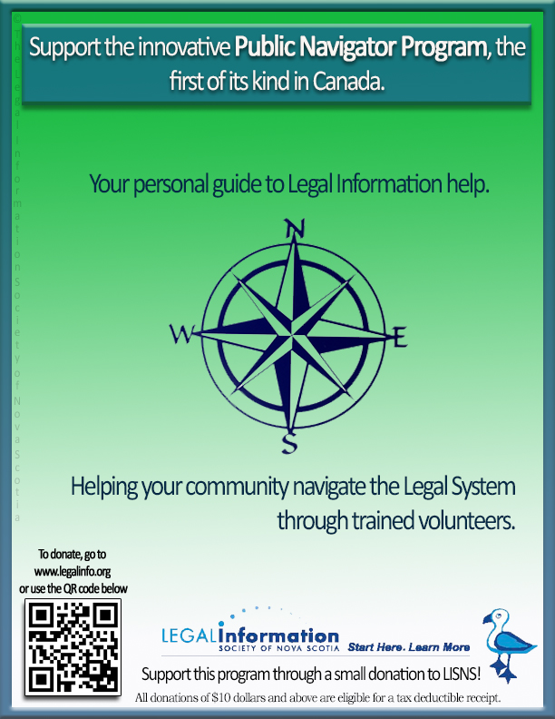
Legal Information Society of Nova Scotia: Public Navigator Program

Slide 19

Public Navigator Project receives CBA-NS 2016 Law Day Award – for innovation in A2J
19

Slide 20
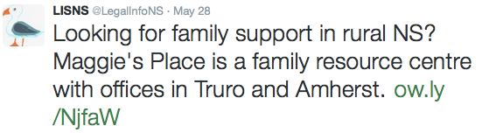
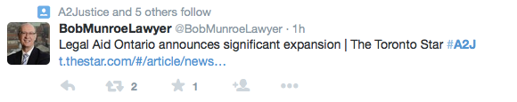



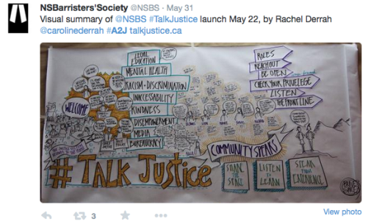

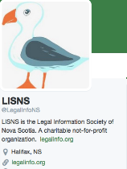

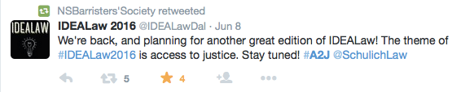



20
Notes:
20

Slide 21
Public Navigator Project (NS)
21
First in Canada (that we can determine)
Response to need of NS Court Administrators
Supported by Chief Justice of Nova Scotia
Complements pro bono initiative in Halifax to provide free legal ADVICE to self-reps (civil litigation issues) in NSSC
Notes:
LISNS ED travelled NS in 2014 and met with staff and community members at the 10 courthouses
Unanimous #1 issue – support for self-rep individuals
First response: Pro Bono roster of lawyers at each courthouse provide half-hour free legal info
Feedback from lawyers – no support
Began in the medical community to assist lower income individuals & remote locations
Link between patients and doctors: streamline process
Develop efficiency
NYC Courts recently began the implementation of Court Navigators
Medical Navigation Programs:
Mexico City’s Juarez Hospital
66% of people with a navigator underwent a quicker process
40% completed their process within a single visit
Overall reduction in waiting times of 60%
Journal Clinical Infectious Diseases – Jan 2015 – telemedicine increases access to care for those in rural areas, transportation issues
Evidence supports tech-delivered therapy with support over the phone or e-mail successful (Globe and Mail June 2015)
Legal Navigation Models
New York City public navigator project – started 2014 http://www.nycourts.gov/courts/nyc/housing/rap_prospective.shtml
Based upon UK McKenzie Friend model (without fee component) – http://courtwithoutalawyer.co.uk/mckenzie-friends.html
The Lawyers Weekly (January 22, 2016) at PDF attached, “Non-lawyers to help self-represented”.
The Canadian Forum on Civil Justice (November 2015) for innovation in access to justice for having looked to inspiration outside of Canada and successfully integrating it into Nova Scotia: http://nsbs.org/national-recognition-lisns-public-navigator-project
The New Law Journal, Fall 2015, (UK), Roger Smith, columns, commented favourably upon legal assistance provided through the models of LISNS and Nova Scotia Legal Aid in http://www.newlawjournal.co.uk/nlj/content/across-pond-0 (Fall 2015)
The CBC TV “The National Program” profiled LISNS work through a one day taping (June 2015) of public navigator training for a series on self-represented individuals across Canada.
CBC News Nova Scotia (April 21, 2016) "Bridgewater volunteers learn to help people representing themselves in court"
allNova Scotia (February 29, 2016) “LEGAL CHARITY PILOT FOR THE SELF-REPRESENTED”;
South Shore community newspapers including LighthouseNOW, South Shore Breaker and the Bridgewater Progress Bulletin (February 2016);
Community groups expressed need for legal information support for self-reps; willingness to support delivery of training if LISNS developed
LISNS does not have project funding – doing through core funding without a budget
Retained a highly capable third year law student to work with LISNS staff and volunteer lawyer/mediator to develop training materials

Slide 22
The role of legal information &personal support
22
Ab Currie’s research (quoted in various A2J Reports) supports:
  the potential value of initial legal information to assist a person in understanding the nature of the problem and courses of action that may be open
  Virtual legal assistance is helpful to over 85% of respondents in resolving the issue
Consistent with LISNS experience assisting over 100,000 callers to the Legal Information Line (legally trained counsellor, toll-free, anonymous)
  Only 25% of callers require a lawyer referral
  75% of callers can address conflict with legal info
Notes:
Federal Department of Justice research indicates nearly 12 million Canadians will experience at least 1 legal problem in any 3 year period.
Many will not be able to afford a lawyer
Most do not seek out information until and unless there is a pressing legal issue/document requiring attention
Digital delivery of legal services to people on low income (Roger Smith, Spring 2015, www.thelegaleducationfoundation.org/digital-report)
Findings reinforce the importance of individuals having access to quality legal information and in-person support to navigate the legal system – in order to build self rep confidence to prepare for the legal system
Recommends improvements in legal information delivery through existing public legal education providers and reinforcing capacity (existing websites)

Slide 23
LISNS and the Public Navigator Program
23
Solution
Public Navigator:
  Provide quality information services to self-represented individuals
  Triage
  Help self-reps understand the health, economic, and emotional implications of going to court.
  Hub for legal information materials. Public navigators will help self-reps access existing legal information.
Notes:
23

Slide 24
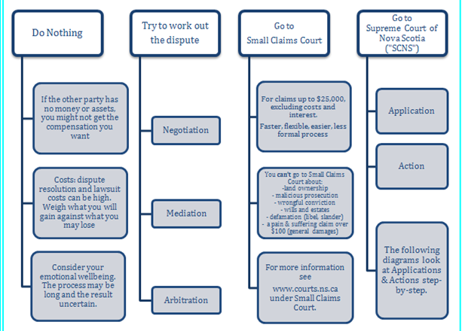
24
Notes:
24

Slide 25
Simplified Decision Making Process
25
Identify the Problem
Analyze the Problem
Develop Alternate Soluitions
Select the Best Solution

Slide 26

Training for Public Navigators
26
Day 1 – Training – Role of Public Navigator, Legal Information vs. Advice, Navigating the Small Claims Court Process
Day 2 – Role Playing – teams of public navigators role playing common issues dealt with through LISNS Legal Information Line – facilitated by retired law professor
Day 3 – How to be your own effective self-advocate – presentation by experienced civil litigator – 9 videos available at:
https://www.youtube.com/playlist?list=PL-H7OWp0Q1oiDuet9fgh-4Vw9i2FmvcEW

Slide 27
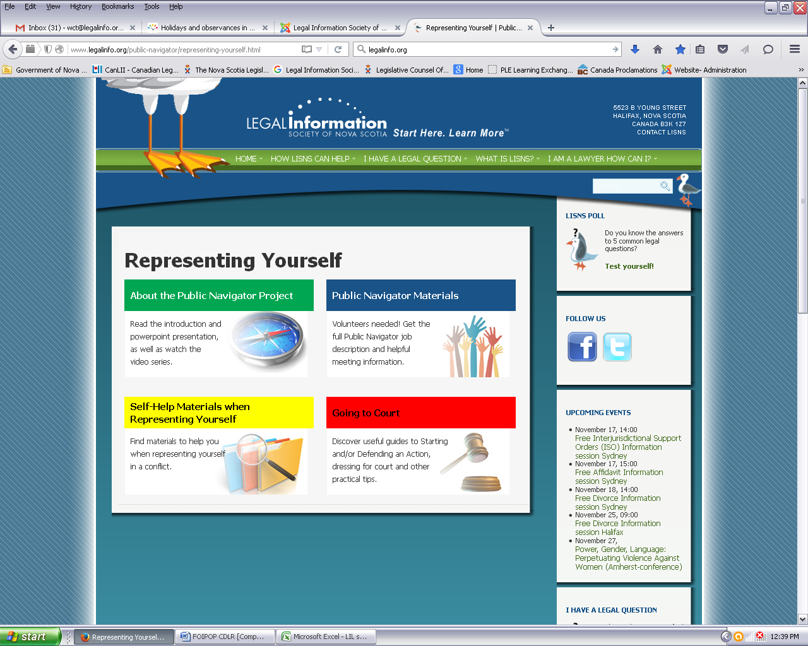
27

Slide 28
Key Goals of Public Navigator Project
28
Self-reps:
  understand their issue(s) and options
  Gain confidence with choosing an option
  Satisfied with the process
  Reduction in # of self-reps proceeding to court
  Properly completed documentation for those choosing to go to court

Slide 29
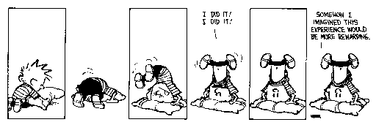
Experience of an SRL
2008-2015 Uncoupling of 17 year marriage;
Expectations:
Calm and focused process that is Relatively Predictable and affordable
A quick, clean division of assets, support for children and amicable co-parenting agreement
Where parties can’t agree a judge makes decision

Slide 30

Reality
Lack of proper information about legal system
Costly and Combative
Unable to speak or understand legalese
Confusing procedures and processes
Loss of control
Inability to find consistent assistance
No Guidelines on how to be an effective SRL

Slide 31

Effects
World turned upside down,
Mentally – distress, overwhelmed, depression, learned helplessness, loss of control …
Physically – unable to sleep, restlessness, nightmares, anxiety attacks …
Emotionally- anxiety, fear, fight/flight, trust issue …
Avoidance of University Ave between Dundas and Queen at all cost.
Financially devastating!

Slide 32
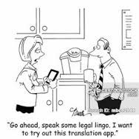
I needed …

Slide 33

SRL Needs cont.
Reasonable cost for legal services
Clearer explanation and understanding of the process before entering the system
Procedural know how’s
Assistance with drafting documents – forms, pleadings and other precedents (prepare motions, conferences, how to negotiate draft minutes of settlement)
Strategy development
Evaluation of settlement proposals
Document Review
Court Support
How to deal with the other side

Slide 34
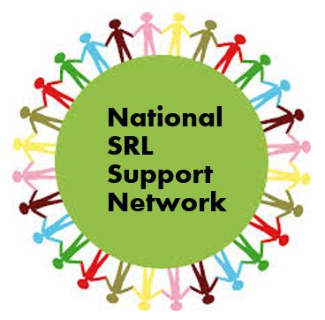
National SRL Support Network (NSSN)
Not for profit organization run by SRL volunteers
2016 by BC, Manitoba and Ontario
Mandate to offer …
Emotional and moral support to SRLs through monthly support group meetings
Quality resources that include online information and services to SRLs
First Ontario SRL support meeting was held in Toronto May 2016
For More information go to
www.supportforcourt.ca

Slide 35

Thank you for listening!

Slide 36
Moving Forward: Developing Student Coaching Programs
A successful student coaching project requires 5 things:
SRLs who would benefit from a student coach
Law student volunteers who would make good coaches
3L law student or someone else to coordinate the project
A lawyer supervisor with subject matter expertise
A comprehensive training program and clear protocols

Slide 37
1. SRLs who would benefit from a student coach
  Figure out best way to reach clients who need services
  Reach out to the NSRLP and SRL Support Groups
  Develop an application form
  Ensure the legal issues are law student-appropriate
  Ensure the client is open to the coaching process
  Have clients sign a coaching contract

Slide 38
2. Law students volunteers who would make good coaches
  Develop student application/selection process
  Identify prerequisites
  Have students sign a confidentiality agreement
  Provide comprehensive training

Slide 39
3. Law student lead (or project coordinator)
  3L student
  Assists with recruitment
  Handles day-to-day logistics, scheduling and coordinating
  Develops training materials and arranges training
  Assists with troubleshooting and provides peer-to-peer training
  Monitors student volunteers and lawyer supervisor
  Gathers project statistics: quantitative and qualitative data

Slide 40
4. Lawyer supervisor with subject-matter expertise
Must be insured
Must be available to review and deliver training materials
Must be available to clarify and troubleshoot
Provides mentorship to the law students – coach the coach
In Ontario – LSUC guidelines require all supervisors to have a “relationship” with a client – need to determine what that entails for him or herself
Ideally will lead post-project debrief with student volunteers

Slide 41
5. Comprehensive training program and clear protocols
    All training materials should be reviewed & delivered by a lawyer
    The basics: Family law, procedure, court rules and forms
    The coaching model and philosophy
    Legal advice vs. information
    Meaningful referrals for students to use
    Familiarize students with challenges faced by SRLs
    “Counselling” skills
    Safety
    Self-care
    Project logistics & protocols

