Slide 1
APPLICATION JOURNEY 2020

Slide 2
The Application process
Apply online or via UCAS
Receive ID number and Portal Log in
View Decision
Accept offer
Upload Qualifications
View Confirmation Decision
Accept Offer
Request CAS and Confirm Deposit paid
View CAS
Apply for Visa
Pre Register Online
Attend Enrolment and Induction

Slide 3
How should they apply?
Online via our website
UCAS (UG)
Lawcabs
GDL and LPC

Slide 4
What happens next?
Applicants will receive an email confirming that their application has been submitted
They will then receive log in details for our applicant portal
The portal will allow them to manage their application throughout the cycle
Agents will be copied into all emails throughout the cycle (except any passwords)
Applicant Services will process the application

Slide 5
The Applicant Portal - Features
View Decision
Accept Offer
Request and download CAS
Upload Documents
Contact US
Update Information
Book Interviews
Complete Fee Questionnaire
Confirm Deposit

Slide 6
Application Outcome
If we have all the information we need to assess the application we will apply a decision. This could be:
  Unconditional : They have met all the academic qualifications
  Conditional : They need to meet the stated conditions
  Unsuccessful : They have unfortunately not been accepted
If we are unable to make an offer on the course applied for, we may offer alternative programmes or intakes

Slide 7
Viewing and responding to offers
When an applicant receives an offer, the portal will be updated with the latest decision
If there are any conditions these will also be displayed.
They will still be sent their offer letter by email so its important they still check their email
Applicants can view their decision and respond to their offer on the portal using the Red ‘Respond to offer’ tile
UCAS applicants should reply via UCAS Track

Slide 8
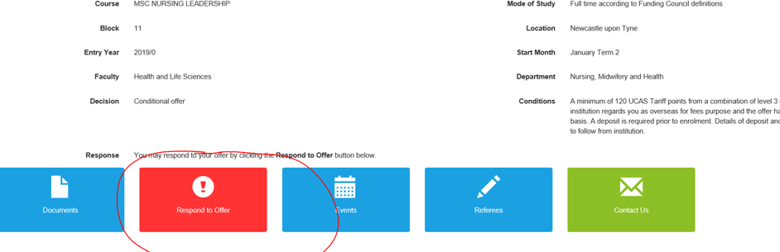
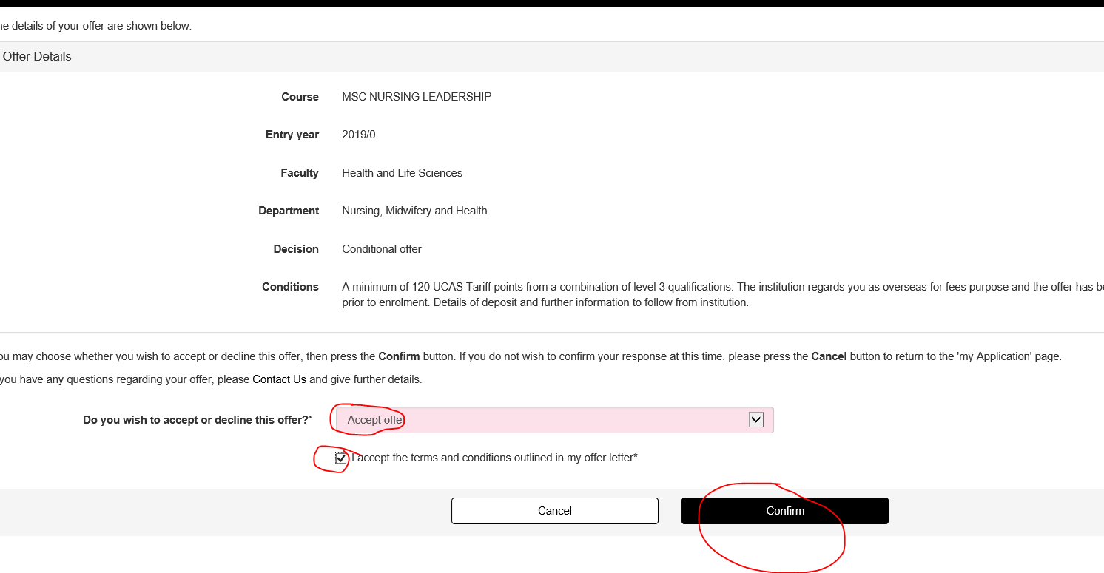
Select the Respond to offer tile
Accept or decline
Ensure applicants read terms and conditions before expecting

Slide 9
If we need more information:
If we have do not have all the information we need to assess the application, we will request the missing information via the portal.
This could be a request to
  Complete a Fee Questionnaire to determine fee status
  Upload document such as transcripts
Applicants and their agents will receive a notification that there has been an update on their portal
Applicants should log on and provide the information needed via the relevant tile that will appear on their portal

Slide 10
Post Offer information
We may also request further information after we have made an offer on the application
  Under 18 Parental Consent form
  ATAS Certificate
  Portfolio
These should also be also be uploaded via the applicant portal when prompted by email.

Slide 11
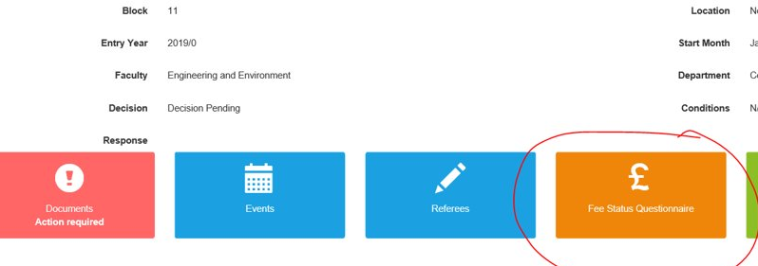
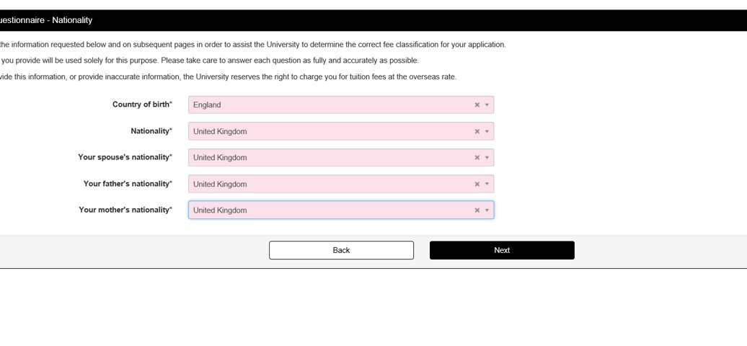
Fee Status Questionnaire
Click on the Orange Tile
Then complete the online questions, uploading document copies when prompted

Slide 12
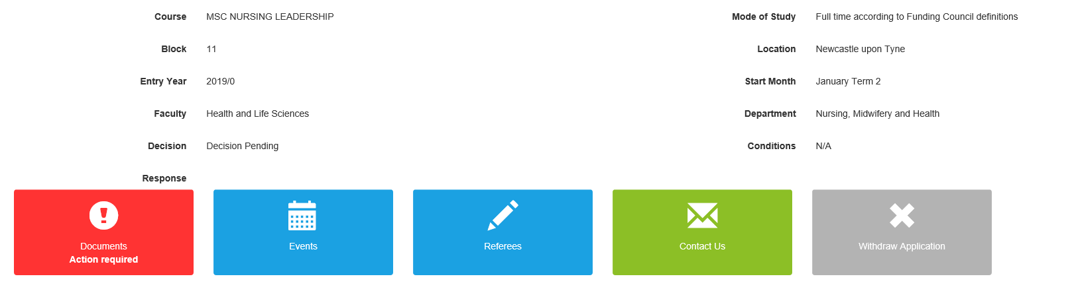
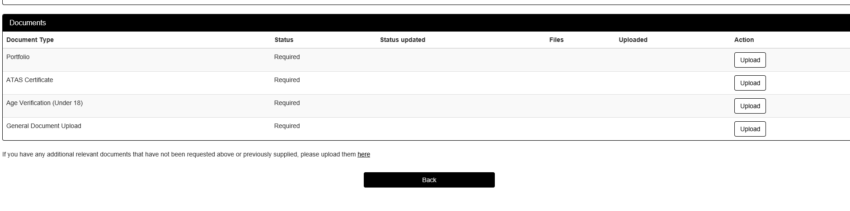
Uploading Documents
Click on the Red Documents Tile
Upload against the requested document against the relevant Upload box

Slide 13
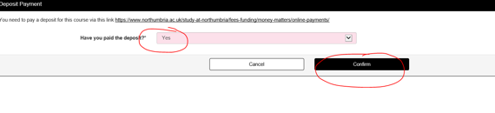
Confirm Deposit Payment
International applicants are required to pay a deposit (exemptions apply). Once the applicant becomes unconditional a ‘Deposit’ tile will appear on the portal.
Students should pay their deposit via our epayments link and then use the tile to confirm they have paid, or alternatively provide evidence of sponsorship

Slide 14
Request their CAS (or confirm not needed)
When an applicant is Unconditional Firm a Red ‘Visa Immigration’ tile will appear on the portal
They should indicate if they need a CAS – Yes or No
They should then indicate if they will be applying inside or outside the UK
If they do not need a CAS they should indicate what immigration they will be using and provide copies where possible.

Slide 15
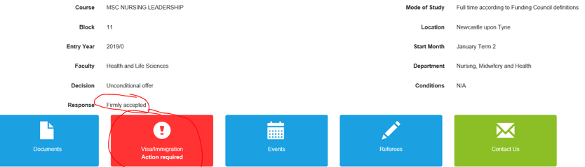
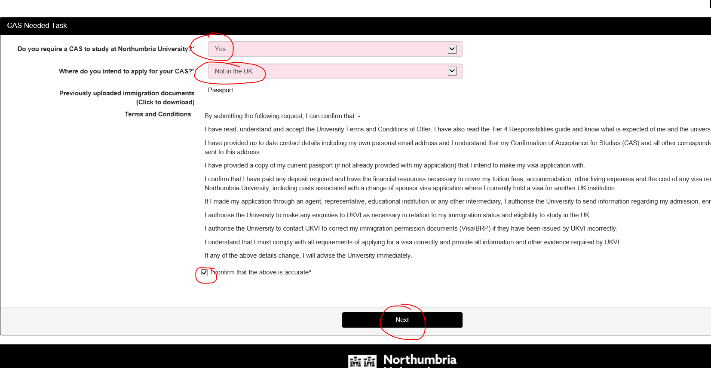
Click the Visa Immigration Tile
Select Yes or No to confirm if a CAS is Required
Indicate where they are applying
Read and accept the information

Slide 16
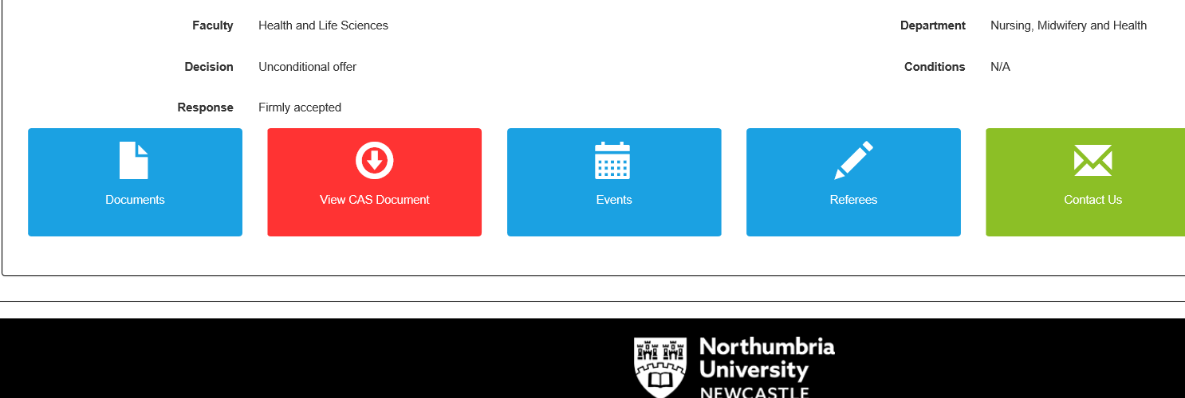

Slide 17
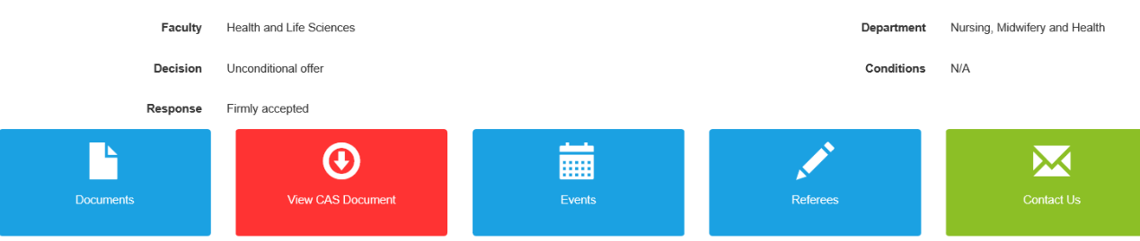
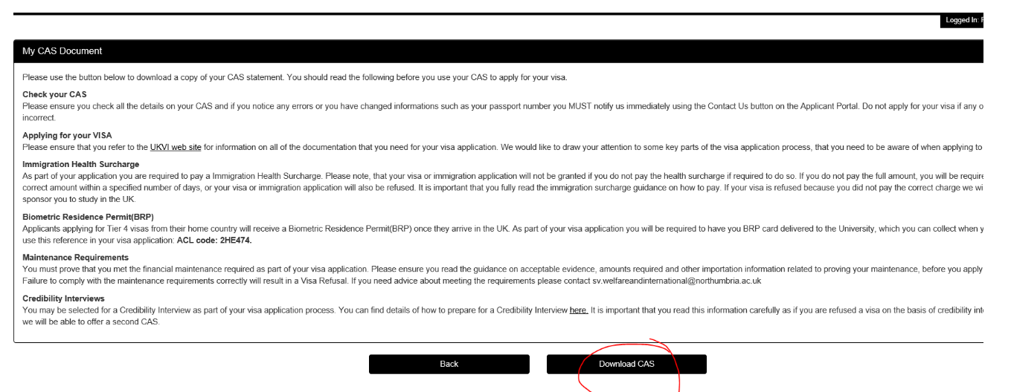
Download CAS
When their CAS has been produced a Red ‘View CAS document’ tile will appear
Click on this to download their CAS and get information on next steps

Slide 18
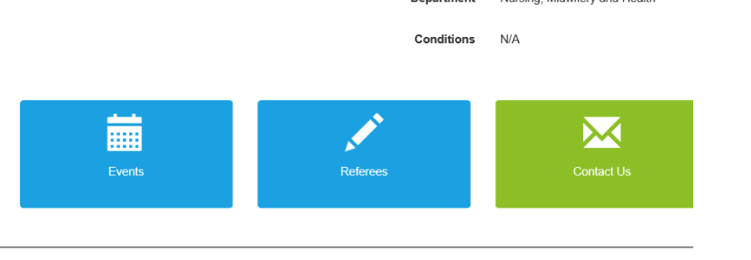
How do they contact Admissions
Applicants should use the ‘Contact us’ tile on the portal
This sends a message to the right team who will respond

Slide 19

Troubleshooting
Here are a few troubleshooting tips for logging in and using the portal if you or applicants have any issues
  Use a device other than an mobile phone
  Follow the link in their email and use Chrome as their browser.
  Copy and paste the username from the Applicant Portal login email including the ‘w’, making sure there are no extra blank spaces at the end
  Clear their browser history so that the device is not storing passwords
  Try the forgotten password link on the log in screen
  Check our common error messages and resolutions here
  If this doesn’t solve the problem ask the applicant to send a full screenshot of the error message to bc.applicantservices@northumbria.ac.uk

